Slide 1
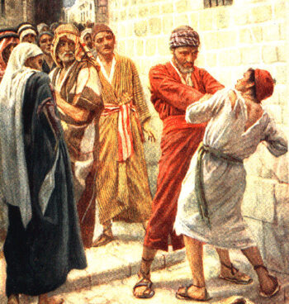
Parable of the Unmerciful Servant
Matthew 18:21-35

Slide 2
A Few Things from Surrounding Context
The immediate reason Jesus spoke this parable—it’s in answer to the question Peter asked in v. 21.
To understand WHY he asked this question, we need to go back to verses 15-17.
And to understand WHY Peter and the other apostles might have some difficulty with forgiveness, we need to go all the way back to v. 1.

Slide 3
A Few Things from Surrounding Context
They asked this question right after Jesus warned them of His suffering and death in 17:22-23.
Verse 24—arrive in Capernaum. Mark 9:33-34 reveals when they arrived there Jesus asked them what they had been arguing about on the road.
Who would be the greatest in the kingdom?

Slide 4
A Few Things from Surrounding Context
His disciples still have an issue with ________.
And what is the underlying issue in one’s unwillingness to forgive?
We have trouble understanding the magnitude of our own sins, but not sins committed against us.

Slide 5
Reading Through the Text

Slide 6
Applications
Ephesians 4:31-32; Colossians 3:12-13.
Luke 17:3-4.
Matthew 6:12, 14-15.
James 2:13
“Blessed are the merciful, for they shall obtain mercy” (Matthew 5:7).
Hebrews 10:29, 31

