Slide 1
Proverbs—Lesson 10
Laziness vs. Diligence

Slide 2
Diligence
In the NKJV, some form of the word diligence is used 20 times in the New Testament.
It is used in connection with seeking God, study, giving, good works, seeking heaven, leading, adding qualities to our character, avoiding sin, and really everything to do with our service to God.
In Proverbs, it’s used in connection with life’s endeavors, keeping one’s heart, seeking wisdom.

Slide 3
“As a door turns on its hinges, so does the lazy man on his bed. The lazy man buries his hand in the bowl; it wearies him to bring it back to his mouth” (26:14-15).

Slide 4
“I like work; it fascinates me. I can sit and look at it for hours.”
Jerome K. Jerome, English author and humorist

Slide 5
The lazy man described in Proverbs has the same “fascination” with work.
“I went by the field of the lazy man, and by the vineyard of the man devoid of understanding; and there it was, all overgrown with thorns; its surface was covered with nettles; its stone wall was broken down” (24:30-31).

Slide 6
“He who is slothful in his work is a brother to him who is a great destroyer” (Proverbs 18:9).

Slide 7
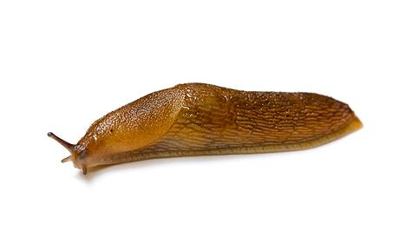
“Go to the ant, you sluggard! Consider her ways and be wise…How long will you slumber, O sluggard?” (Proverbs 6:6, 9).

Slide 8
Characteristics of the Sluggard
A sluggard sleeps too much; he sleeps when he should be working.
(6:9-11).
“Do not love sleep, lest you come to poverty; open your eyes, and you will be satisfied with bread” (20:13).
How do we know when we’re sleeping too much?
Can one be awake physically, but asleep in another sense?

Slide 9
Characteristics of the Sluggard
A sluggard talks when he should be working, or maybe talks about working instead of actually doing it.
“In all labor there is profit, but idle chatter (“mere talk”—NAS) leads only to poverty” (14:23).
Can’t we work and talk at the same time?

Slide 10
Characteristics of the Sluggard
A sluggard makes excuses to get out of work, excuses that sometimes border on the ridiculous.
The lazy man says, “There is a lion outside! I shall be slain in the streets!” (22:13), or, “There is a lion in the road! A fierce lion is in the streets!” (26:13).
Do you have to feel just right to work?
Do conditions have to be perfect?

Slide 11
Characteristics of the Sluggard
A sluggard is not nearly as smart as he thinks he is.
“The lazy man is wiser in his own eyes than seven men who can answer sensibly” (26:16).
Some folks might not be willing to do a job, but they can sure tell you what?

Slide 12
Characteristics of the Sluggard
A sluggard follows after frivolity—he likes to goof off.
“He who tills his land will be satisfied with bread, but he who follows frivolity is devoid of understanding” (12:11).
“He who tills his land will have plenty of bread, but he who follows frivolity will have poverty enough! (28:19).
If you’ve got enough energy to goof off…

Slide 13
Characteristics of the Sluggard
A sluggard thinks he’s making life easier for himself, but he’s actually making it more difficult.
“The way of the lazy man is like a hedge of thorns (NRS—“overgrown with thorns”), but the way of the upright is a highway” (15:19).
But doesn’t the upright, diligent person face obstacles, too?

Slide 14
Characteristics of the Sluggard
A sluggard is not afforded the same opportunities as the diligent.
“The hand of the diligent will rule, but the lazy man will be put to forced labor” (12:24).
“Do you see a man who excels in his work? He will stand before kings; he will not stand before unknown men” (22:29).

Slide 15
Characteristics of the Sluggard
A sluggard is a big source of irritation to others.
“As vinegar to the teeth and smoke to the eyes, so is the lazy man to those who send him” (10:26).

