Slide 1
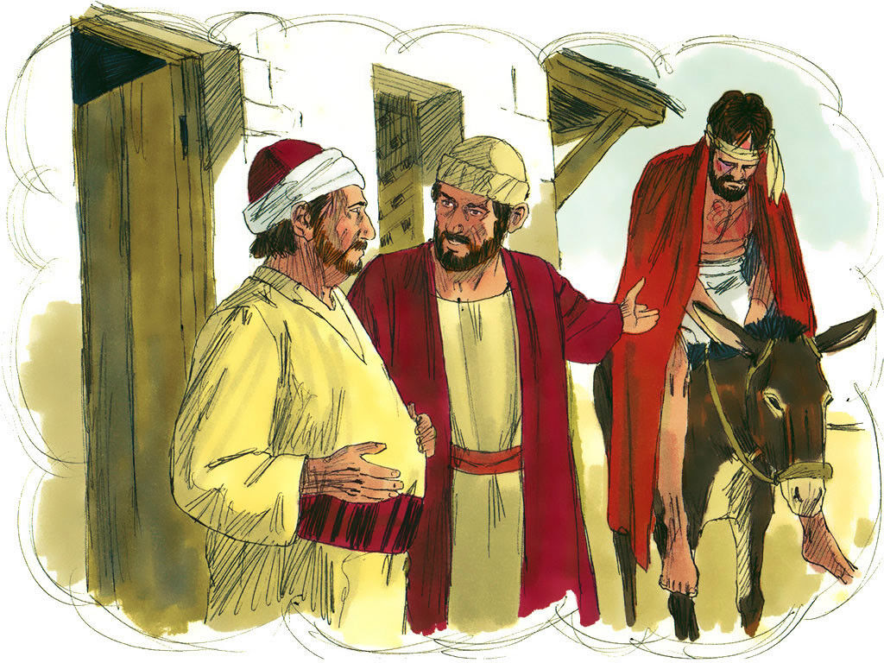
Parable of the Good Samaritan
Luke 10:25-37

Slide 3
“A certain lawyer” (25)
Don’t think in terms of Johnnie Cochran, or Alexander Shunnarah.
A lawyer (“scribe”) was considered an expert (?) in the law of Moses.
Many run-ins with Jesus. *Matthew 23*
“They say, and do not DO” (Matt. 23:2).

Slide 4
“A certain Samaritan” (33)
Hatred between Jews and Samaritans.
“Jews have no dealings with Samaritans” (John 4:9). *Problems on both sides.*
“Are we not right in saying you are a Samaritan and have a demon?” (John 8:48).
Lawyer didn’t say the Samaritan (36-37).

Slide 5
The Priest and Levite (31-32)
Had important duties at the temple, which explains why at various times they would have been coming to or from Jerusalem.
Priests: In addition to offering sacrifices… “teach the children of Israel all the statutes which the LORD has spoken…” (Lev. 10:11).
These statutes included…

Slide 6
The Priest and Levite (31-32)
“Love your neighbor as yourself” (Lev. 19:18); care for neighbor’s animal, even if neighbor is your enemy, even if he hates you (Ex. 23:4-5).
Again, someone who said and didn’t DO.
Priest and Levite may have faithfully performed duties at the temple, but they failed to show mercy and compassion.

Slide 7
Lesson #1
“Be doers of the word, and not hearers only, deceiving yourselves” (James 1:22).
“DO this and you will live” (28); “Go and DO likewise” (37).
“Who is wise and understanding among you? Let him SHOW by his good conduct…” (James 3:13).

Slide 8
Lesson #2
“Let our people learn to devote themselves to good works, so as to help cases of urgent need, and not be unfruitful” (Titus 3:14).
Can be entirely too selective in who we help (“neighborhood” too small).
“As we have opportunity, let us do good to ALL…” (Galatians 6:10).

Slide 9
Lesson #3
“For He Himself is kind to ungrateful and evil men” (Luke 6:35, NAS). *Romans 5:8*
Didn’t respond to something good in this man (didn’t know anything about him).
Neighbor love is not a response to goodness in others, but to their need.

Slide 10
Lesson #4
“And I will very gladly spend and be spent for your souls” (2 Corinthians 12:15).
Can also be too selective in HOW we help (not a problem for the Samaritan).
Must be willing to do what’s hard, awkward, uncomfortable, outside of comfort zone, etc.

Slide 11
Lesson #5
“What does the Scripture say?” (Romans 4:3).
Asked about what to do to receive eternal life, Jesus directed this man to the word of God.
That’s where ALL the answers are found (“all things that pertain to life and godliness”), and they’re clear enough to understand.

