Slide 1
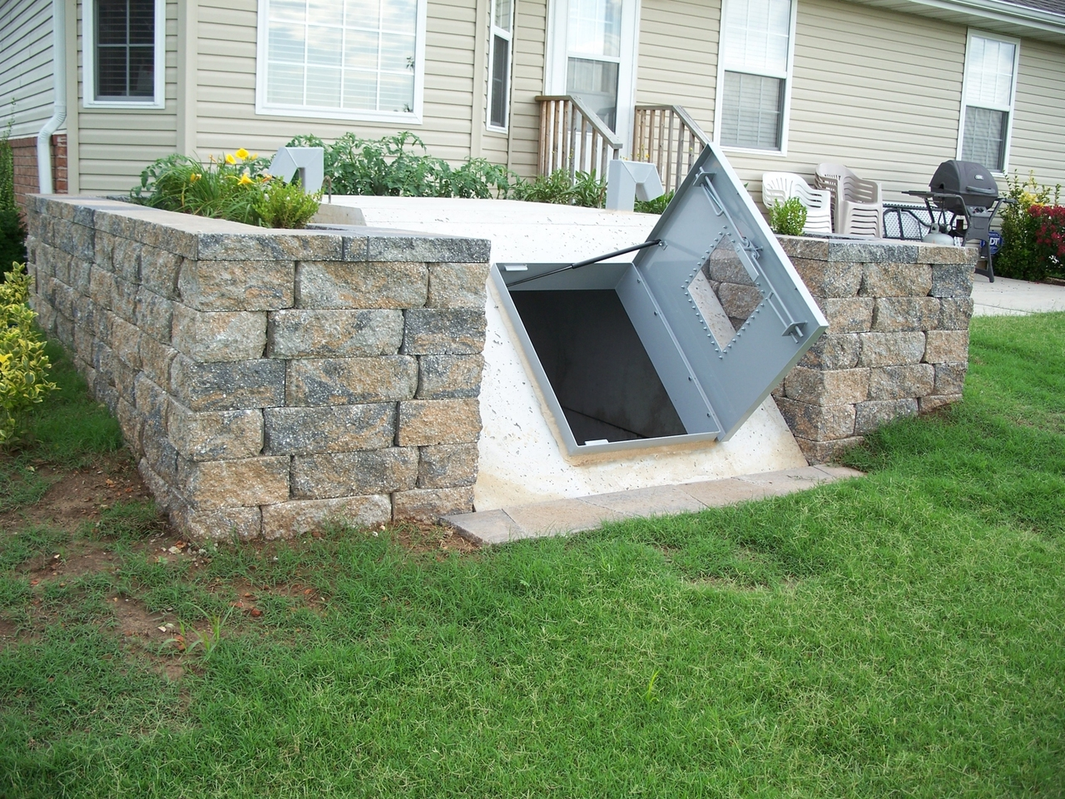
Notes:
What you see here, of course, is a storm shelter, a place of refuge. Looks like this family has built a really nice one. But as secure as this place of refuge may be, it can only protect them from physical harm. When it comes to protecting us, especially from spiritual harm, God is our refuge.

Slide 2
God is our Refuge
“The eternal God is your refuge, and underneath are the everlasting arms…” (Deut. 33:27).
“God is our refuge and strength, a very present help in trouble” (Psa. 46:1).
“…for my soul trusts in You; and in the shadow of Your wings I will make my refuge, until these calamities have passed by” (Psa. 57:1).

Slide 3
God is our Refuge
“…and under His wings you shall take refuge; His truth shall be your shield and buckler” (Psa. 91:4).
“In the fear of the LORD there is strong confidence, and His children will have a place of refuge” (Prov. 14:26).

Slide 4
This “place” of refuge
Found in our relationship to God through Jesus Christ (Hebrews 6:17-20).
Formed and maintained by faithful obedience (Matt. 7:24-27; 1 John 2:3-6).
Offers a refuge from many harmful things, but especially from sin and its consequences.

Slide 5
God is our refuge…
From substance abuse.
By teaching us to not be brought under the control of anything (1 Cor. 6:12).
By offering us better ways to cope.
Notes:
Addictions—by teaching us not to be brought under the control of anything (1 Cor. 6:12), but also by giving us other means to cope, than these addictions.
Sexual immorality—passages like 1 Corinthians 6:13-20; 1 Thessalonians 4:1-8, and much of Proverbs 1-9.
Love of money—passages like 1 Timothy 6:9-10.

Slide 6
God is our refuge…
From sexual immorality and its consequences.
By teaching us the sanctity of marriage (Hebrews 13:4).
By showing that sexual relations outside marriage are sinful (1 Cor. 6:13-20; 1 Thess. 4:1-8).
Notes:
Addictions—by teaching us not to be brought under the control of anything (1 Cor. 6:12), but also by giving us other means to cope, than these addictions.
Sexual immorality—passages like 1 Corinthians 6:13-20; 1 Thessalonians 4:1-8, and much of Proverbs 1-9.
Love of money—passages like 1 Timothy 6:9-10.

Slide 7
God is our refuge…
From the perils of greed.
By warning us about the love of money, by revealing its many temptations and snares, and by giving us a better set of priorities. 1 Tim. 6:9-11.
Notes:
Addictions—by teaching us not to be brought under the control of anything (1 Cor. 6:12), but also by giving us other means to cope, than these addictions.
Sexual immorality—passages like 1 Corinthians 6:13-20; 1 Thessalonians 4:1-8, and much of Proverbs 1-9.
Love of money—passages like 1 Timothy 6:9-10.

Slide 8
God is our refuge…
From the fear of failure.
By completely redefining prosperity and success. Matt. 20:26; 3 John 1:2.
“Of whom the world was not worthy” (Heb. 11:38).
2 Cor. 5:17.
Notes:
Addictions—by teaching us not to be brought under the control of anything (1 Cor. 6:12), but also by giving us other means to cope, than these addictions.
Sexual immorality—passages like 1 Corinthians 6:13-20; 1 Thessalonians 4:1-8, and much of Proverbs 1-9.
Love of money—passages like 1 Timothy 6:9-10.

Slide 9
God is our refuge…
The rebellious spirit which clashes with authority.
By replacing it with an attitude of submission to authority. 1 Pet. 2:13-3:12.
Notes:
Addictions—by teaching us not to be brought under the control of anything (1 Cor. 6:12), but also by giving us other means to cope, than these addictions.
Sexual immorality—passages like 1 Corinthians 6:13-20; 1 Thessalonians 4:1-8, and much of Proverbs 1-9.
Love of money—passages like 1 Timothy 6:9-10.

Slide 10
God is our refuge…
The despair that comes from being unloved.
By assuring us of His great love (Rom. 8:35-39).
By surrounding us with brethren who lay down their lives for us (1 Jn. 3:16-18).
Notes:
Addictions—by teaching us not to be brought under the control of anything (1 Cor. 6:12), but also by giving us other means to cope, than these addictions.
Sexual immorality—passages like 1 Corinthians 6:13-20; 1 Thessalonians 4:1-8, and much of Proverbs 1-9.
Love of money—passages like 1 Timothy 6:9-10.

Slide 11
God is our refuge…
From the crippling effects of anxiety.
By giving us the perfect prescription for the “peace of God, which surpasses all understanding” (Philippians 4:6-9).
Notes:
Addictions—by teaching us not to be brought under the control of anything (1 Cor. 6:12), but also by giving us other means to cope, than these addictions.
Sexual immorality—passages like 1 Corinthians 6:13-20; 1 Thessalonians 4:1-8, and much of Proverbs 1-9.
Love of money—passages like 1 Timothy 6:9-10.

Slide 12
God is our refuge…
From the self-serving attitude that destroys so many relationships.
By teaching us to deny or crucify ourselves (Luke 9:23; Galatians 2:20).
And to esteem others better than ourselves (Philippians 2:3-8).
Notes:
Addictions—by teaching us not to be brought under the control of anything (1 Cor. 6:12), but also by giving us other means to cope, than these addictions.
Sexual immorality—passages like 1 Corinthians 6:13-20; 1 Thessalonians 4:1-8, and much of Proverbs 1-9.
Love of money—passages like 1 Timothy 6:9-10.

Slide 13
God is our refuge…
From other poisonous attitudes like wrath, bitterness, and envy.
By replacing these with self-control, gratitude, kindness, tenderheartedness, etc. (Eph. 4:31-32; James 3:13-18).
Notes:
Addictions—by teaching us not to be brought under the control of anything (1 Cor. 6:12), but also by giving us other means to cope, than these addictions.
Sexual immorality—passages like 1 Corinthians 6:13-20; 1 Thessalonians 4:1-8, and much of Proverbs 1-9.
Love of money—passages like 1 Timothy 6:9-10.

Slide 14
God is our refuge…
From the heartaches of this life.
Not by removing them, but by giving us sufficient grace to cope (2 Corinthians 12:9).
By promising us something far better in the life to come (Revelation 21:4).
Notes:
Addictions—by teaching us not to be brought under the control of anything (1 Cor. 6:12), but also by giving us other means to cope, than these addictions.
Sexual immorality—passages like 1 Corinthians 6:13-20; 1 Thessalonians 4:1-8, and much of Proverbs 1-9.
Love of money—passages like 1 Timothy 6:9-10.

Slide 15
God is our refuge…
From the shackles of denominationalism.
By teaching us a way we can simply be Christians, serving Christ and Him alone.
He is a refuge from the traditions of men.
Notes:
Addictions—by teaching us not to be brought under the control of anything (1 Cor. 6:12), but also by giving us other means to cope, than these addictions.
Sexual immorality—passages like 1 Corinthians 6:13-20; 1 Thessalonians 4:1-8, and much of Proverbs 1-9.
Love of money—passages like 1 Timothy 6:9-10.

Slide 16
God is our refuge…
From the condemnation of sin.
By assuring His children that if we repent and confess our wrongs, “He is faithful and just to forgive us our sins and to cleanse us from all unrighteousness (1 John 1:9).
Notes:
Addictions—by teaching us not to be brought under the control of anything (1 Cor. 6:12), but also by giving us other means to cope, than these addictions.
Sexual immorality—passages like 1 Corinthians 6:13-20; 1 Thessalonians 4:1-8, and much of Proverbs 1-9.
Love of money—passages like 1 Timothy 6:9-10.

Slide 17
God is our refuge…
From the fear of death (Hebrews 2:14-15)
By promising us that if we live and believe in Him, we will live again, that we will in fact live forever with Him (John 11:23-26; 1 Thess. 4:13-18).
“When this corruptible has put on incorruption, and this mortal has put on immortality, then shall be brought to pass the saying…‘Death shall be swallowed up in victory’” (1 Corinthians 15:54).
Notes:
“What have I to dread, what have I to fear, leaning on the everlasting arms? I have blessed peace with my Lord so near, leaning on the everlasting arms.”

Slide 18
CONCLUSION:
“I will say of the LORD, ‘He is my refuge and my fortress; My God, in Him I will trust’” (Psalms 91:2).

