Slide 1
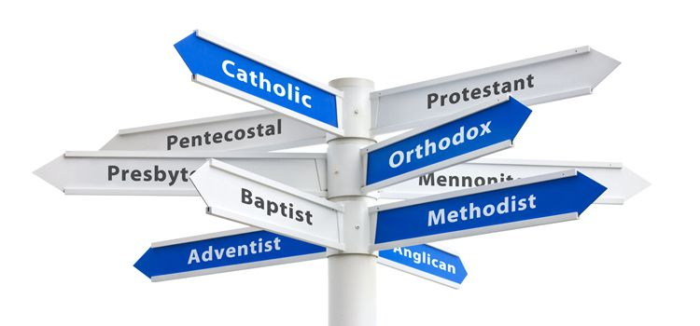
Why I Left Denominationalism Behind.

Slide 2
Because Jesus Only Built One Church.
Matthew 16:18 “And I tell you, you are Peter, and on this rock I will build my church, and the gates of hell shall not prevail against it”
Ephesians 1:22-23 “22 And hath put all things under his feet, and gave him to be the head over all things to the church, 23 Which is his body, the fulness of him that filleth all in all.”

Slide 3
Because To Denominate Is To Be Divided.
1 Corinthians 1:10 “10 Now I beseech you, brethren, by the name of our Lord Jesus Christ, that ye all speak the same thing, and that there be no divisions among you; but that ye be perfectly joined together in the same mind and in the same judgment.”
John 17:21 “21 That they all may be one; as thou, Father, art in me, and I in thee, that they also may be one in us: that the world may believe that thou hast sent me.”

Slide 4
Because To Denominate Is To Be Divided.
The success of the early church seems to have been predicated upon their dedication to unity.
Disunity was never the plan of God for His church.
Disunity gives a picture to the lost world that God is not able to clearly communicate His message.

Slide 5
Because There Is Only One Plan of Salvation.
There is one faith.
There is One Lord.
There is one baptism.
Immersion in water is inextricably linked to being born again by the writers of The New Testament. To separate these events is to preach another Gospel that is foreign to the New Testament.

