Slide 1
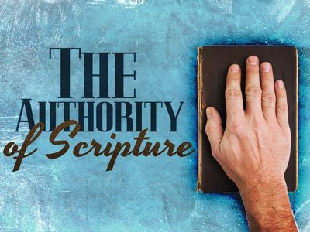

Slide 2
The Authority of Scripture
“If Christ is not raised, your faith is futile” (1 Cor. 15:17).
Other translations: “vain”; “useless”; “worthless”

Slide 3
However…
If Christ IS raised…
Our faith is anchored in a firm foundation.
Our faith is worthwhile.
Our faith is priceless.
And this includes our faith in the Scriptures.

Slide 4
Here’s how it works…
If Jesus was raised from the dead…
He is indeed the Son of God.
And if He is the Son of God, He speaks TRUTH—final, authoritative truth.
Whatever He says concerning Scripture is the final word.
Notes:
On the connection between resurrection and declaration as Son of God, see Romans 1:4.

Slide 5
What did HE say about the O.T.?
MUST be fulfilled.
Matthew 5:17-18; Luke 24:44.
CANNOT be broken, or set aside.
John 10:34-36.
Settled arguments with Scripture
“It is written”; “Have you not read?”
Quoted from at least 13 O.T. books.
Cited a number of different historical events.

Slide 6
Jesus and the Old Testament

Slide 7
What did HE say about the N.T.?
John 14:25-26; 15:26-27; 16:12-15.
What I spoke, the Holy Spirit will bring to your remembrance.
The rest of what I have to say (all truth)—the Holy Spirit will teach you that, too.
You (apostles) will bear witness of these things.
And that’s exactly what happens—Eph. 3:1-5.

Slide 8
Jesus and the New Testament

Slide 9
Authority of Scriptures rests on resurrection!
Why do I believe God created the heavens and the earth in 6 days?
Why do I believe the flood happened?
How do I know the Red Sea was parted?
Is it too incredible that the walls of Jericho fell down after they were circled for seven days?
How do I know a donkey spoke to Balaam?

Slide 10
Authority of Scriptures rests on resurrection!
Why do I believe the N.T. is the final authority on every moral issue? (abortion, homosexuality, transgenderism, etc.).
Why do I cling to every promise the N.T. makes to followers of Christ?
“Standing on the promises that cannot fail, when the howling storms of doubt and fear assail, by the living word of God I shall prevail, standing on the promises of God.”

Slide 11
Conclusions
Don’t ever give up the authority of the Scriptures when discussing spiritual issues with others. Whichever authority they cite (statistics, science, etc.) does not have the resurrection to back up its claims.
So no, we’re not silly or stupid in defending the authority of the Scriptures, because this authority rests on the firmest of all foundations.

Slide 12
Conclusions
Science is quite helpful in explaining the world in which we live, but it is NOT the final authority.
If science/nature can be used to support or supplement some Biblical truth, use it (e.g., Rom. 1:26); but if its claims ever contradict Jesus, choose Jesus.

Slide 13
Conclusions
Yes, the evidence for His resurrection is overwhelming, so don’t be afraid to go to your grave defending the authority of the Scriptures.
“How firm a foundation, ye saints of the Lord, is laid for your faith in His excellent word! What more can He say than to you He has said, You who unto Jesus for refuge have fled?”
Notes:
And what a refuge He is! A refuge of peace, of safety, and of absolute assurance.
Use 1 Corinthians 15:58 to conclude, explaining its connection to the passage used earlier—1 Cor. 15:17.

