Slide 1
Minor Prophets Lesson 5
Introduction, Overview of Jonah
Jonah 1-2

Slide 2
The Man and the Date of His Work
“Jonah the son of Amittai” (Jonah 1:1).
Additional information provided in 2 Kings 14:23-25:
Jonah from Gath Hepher, a village about 4 miles northeast of what was later the city of Nazareth (region of Galilee).
He prophesied during the reign of Jeroboam II in Israel (ca. 793 B.C. to 752 B.C.).
Apparently, this “restoration” of Israel was prophesied by Jonah.

Slide 3
Assyria
Assyria was in a period of decline between Shalmaneser III (859-824 B.C.) and Tiglath-Pileser (745-727 B.C.).
This no doubt helped Israel to expand under Jeroboam II and Judah under Uzziah, and it perhaps helps explain Nineveh’s readiness to repent.
Keep in mind, though, that Assyria had inflicted much suffering upon the people of the world (their “war machine” was something to behold).
Assyria will not many years later carry Israel into captivity.

Slide 4
Outline
Jonah’s Disobedience—Jonah Runs Away from God (1)
Jonah’s Prayer—Jonah Runs To God (2)
Jonah Preaches to Nineveh—Jonah Runs With God (3)
Jonah Complains to God—Jonah Runs Ahead of God (4)

Slide 5
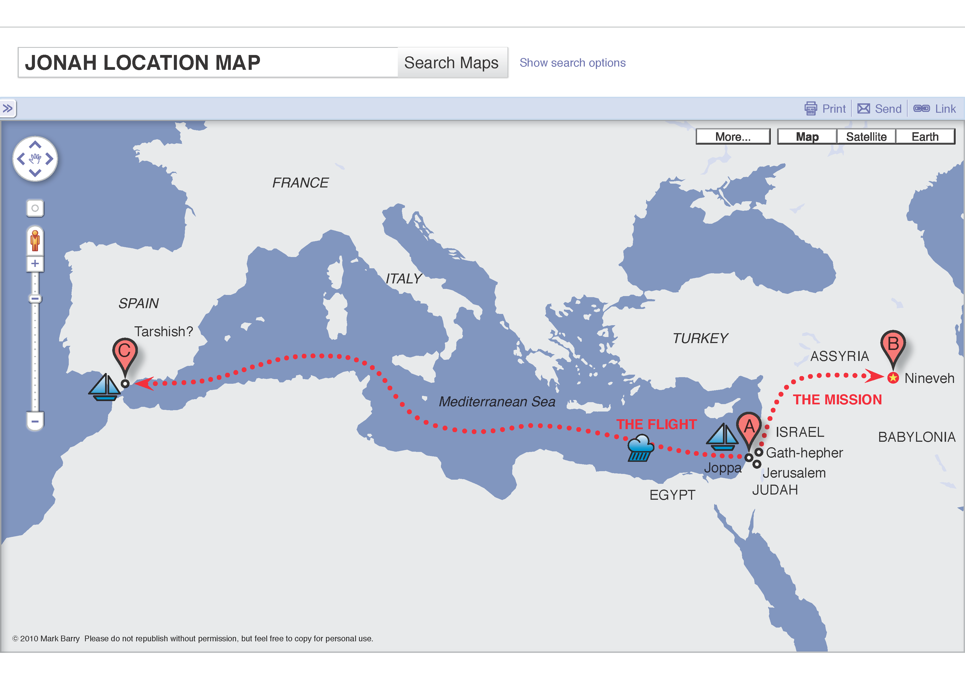

Slide 6
Sound about right?
"Most of us come somewhere between Jesus and Jonah in our attitude toward the lost. We are like Jesus in that we do not want to see them lost, but we are like Jonah in that we are much more concerned with our gourds than with the spiritual needs of lost people. Air conditioning is our gourd! And we have lots of other gourds: central heat and microwave ovens and electric dishwashers and disposals and washing machines and riding lawn mowers to say nothing of automobiles and motorboats and on and on. Jonah's gourd looks pretty modest compared to all of these. Jonah was not concerned at all about the great city of Nineveh, except that he hoped to see it destroyed; but when his gourd withered, he really became upset at its loss." --Sewell Hall

Slide 7
God’s Activity
Told Jonah to go preach to Nineveh (1:1-2).
Sent out a great wind on the sea (1:4).
Caused the lot to fall on Jonah (1:7).
Calmed the sea (1:15).
Prepared a great fish to swallow Jonah (1:17).
Heard Jonah’s prayer and answered it (2:2).
Ordered the fish to vomit Jonah onto dry land (2:10).

Slide 8
God’s Activity
Told Jonah a second time to preach to Nineveh (3:1-2).
Saw that Nineveh repented and so He repented—from the disaster He was going to bring on them (3:10).
Responded to Jonah’s angry prayer (4:4).
Prepared a plant (gourd, vine) to shade Jonah (4:6).
Prepared a worm to wither the plant (4:7).
Rebuked Jonah for his concern for the plant vs. his lack of concern for the souls in Nineveh (4:9-11).

Slide 9
Results
Exposed Jonah’s futile efforts to hide from Him.
Showed His dominion over all creation (winds, waves, plants, animals, etc.).
Convinced exceedingly afraid men to fear Him exceedingly.
Weakened Jonah so he could become strong.
Convinced a nation to repent.
Exposed Jonah’s selfish concerns.

