Slide 1
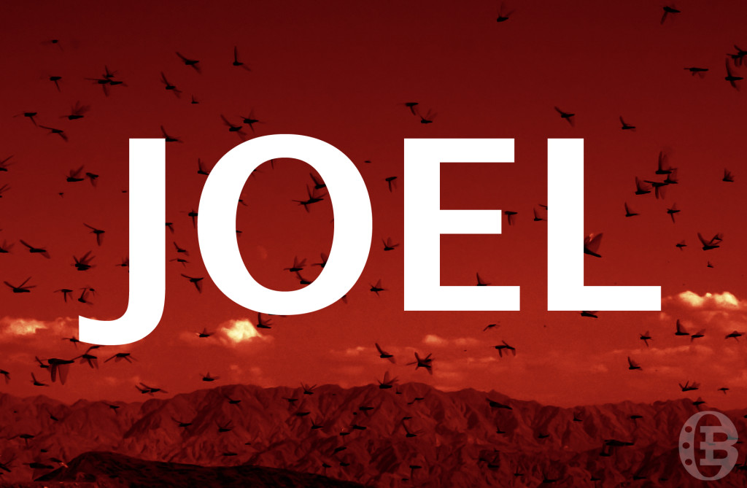
Tonight’s Lesson:
Quick Review of Obadiah
Introduction to Joel
Reading, Discussion of Joel 1:1-2:17

Slide 2
What we learned from Obadiah
Safety, refuge, salvation—you won’t find it in the “clefts of the rock” (1:3); you won’t find it in “your confederacy” (1:7); and you won’t find it among your “wise men” (1:8-9). Deliverance can only be found in Mount Zion, in the kingdom of the Lord (1:17-21).
“Who will bring me down?...I will bring you down” (1:3-4). “Pride goes before destruction, and a haughty spirit before a fall” (Proverbs 16:18).

Slide 3
What we learned from Obadiah
Pride was not the only issue for Edom—so was a lack of love for their “brother” Jacob.
They watched while foreigners ransacked their brother’s city (“were as one of them”) (1:11).
They rejoiced in their brother’s destruction, while boasting of their safety (1:12).
They entered their brother’s city and shared in the spoils (1:13).
They cut off their brethren who were trying to escape (1:14).

Slide 5
Author
Who is this prophet Joel?
He’s the “son of Pethuel” (1:1), and that’s about all we know.
His name means, “YAHWEH is God,” and so like Obadiah (“servant of YAHWEH”), was a very popular name among Jews.

Slide 6
Date
Various dates have been assigned to this prophecy, from 900 B.C. to 400 B.C.
Evidence for earlier date, perhaps around 830 B.C.
In earliest collections of Scripture (the Hebrew canon, and the Septuagint), Joel is grouped among the earliest prophets.
Enemies mentioned in Joel (Philistia, Egypt, Phoenicia, Edom) were their earliest enemies, as opposed to Assyria, Babylon, Persia (later enemies).
Conditions described in Joel fit well with early rule of Joash, king of Judah, while under the direction of Jehoiada, the priest (several mentions of priesthood, none of king).

Slide 7
Locust Invasions
Palestine was struck by a locust invasion in 1915, one which was described vividly by John D. Whiting in the December, 1915, edition of National Geographic (pp. 511-550).
We’ll use some selected quotes from that article, and these will sound eerily similar to what we read in Joel.

Slide 8
Selected Quotes
“Two months after their first appearance, not only was every green leaf devoured, but the very bark was peeled from the trees, which stood out white and lifeless, like skeletons. The fields were stripped to the ground.”
“Swarms of locusts had flown overhead in such thick clouds as to obscure the sun for the time being.”
“Before they were seen, a loud noise, produced by the flapping of myriads of locust wings, was heard.”

Slide 9
Selected Quotes
“Up and up the city walls and the castle they climbed to their very heights.”
“A peasant woman on the plain of Sharon, during the locust pest, employed herself in trying to drive the creeping locusts out of her orchard. She took a tiny baby with her, and laying it in the shade of a tree, proceeded to her work. Returning shortly after, she found the child literally covered with the insects and its eyes already consumed out of the sockets.”

Slide 10
Questions
T F The old men could remember another time comparable to this destruction (1:2).
So significant was this plague he told them to do what? (1:3).
Joel 2:2: “A people come, great and strong, the like of whom has never been; nor will there ever be any such after them, even for many successive generations.”

Slide 11
Questions
What had the various locusts eaten? (1:4).
What was left, the others ate.
Some debate about whether these were different stages of a locust, or four different types of locusts.

Slide 12
Questions
How did Joel describe the “nation” that would come up against the land? (6).
And what had this “nation” laid waste, stripped, ruined? (7).
Here’s how National Geographic described a locust plague which hit Jerusalem (and surrounding areas) in 1915: “Two months after their first appearance, not only was every green leaf devoured, but the very bark was peeled from the trees, which stood out white and lifeless, like skeletons. The fields were stripped to the ground. Even Arab babies, left by their mothers in the shade of some tree, had their faces devoured before their screams were heard.”

Slide 13
Questions
Why would the ministers of the altar (priests) lie all night in sackcloth? (13).
Are they the only ones weeping?
Farmers and vinedressers (11), therefore drinkers of wine and drunkards (5), herds of cattle and flocks of sheep (18), beasts of the field (20).
Note how the mourning is described in v. 8: “lament like a virgin girded with sackcloth for the husband of her youth.”

Slide 14
Questions
Though Joel describes an agricultural devastation, he calls it the “day” of what and “destruction” from whom? (1:15).

Slide 15
Questions
Describe the land before in contrast to the land behind the locusts (2:3).
“Garden of Eden…desolate wilderness.”

Slide 16
Questions
What is the “noise” like of the Lord’s army? (2:5).
Like whom would they “run,” climb,” and “march”? (2:7).

Slide 17
Questions
“Therefore” the Lord called Israel to do what? (2:12-16).

Slide 18
Questions
What should the weeping priests say to the Lord? (2:17).

Slide 19
Minor Prophets: Lesson 4
Joel 2:18-3:21

Slide 20
Review of Joel 1:1-2:17
We know Joel is “the son of Pethuel” (1:1), and that’s about it.
Various dates have been assigned to this prophecy, from 900 B.C. to 400 B.C. (evidence seems to favor an earlier date).
An impending locust plague, one that will bring great devastation, is used to call the people to repentance. The nature of that repentance is described in 2:12-14.

Slide 21
Zeal, Pity for His People (2:18-27)
*The Lord would answer their penitence by sending what? (2:18-19).
T F God promised to restore the years the locust had eaten (2:25).
Who was the Lord’s “great army” He sent among them? (2:25).
T F His people, in this new condition, would never be ashamed (2:26-27).
What would Israel know about the Lord through this judgment? (2:27).

Slide 22
“Lament and mourn and weep! Let your laughter be turned to mourning and your joy to gloom” (James 4:9).
Here in Joel, God exhorts them to do the very opposite (conditioned on their repentance, of course).

Slide 23
Be glad and rejoice! (2:21, 23)
“I will send you grain and new wine and oil…” (2:19).
“I will no longer make you a reproach among the nations” (2:19).
“I will remove far from you the northern army…” (2:20).
“He will cause the rain to come down for you—the former rain, and the latter rain…threshing floors shall be full of wheat…vats shall overflow with new wine and oil” (2:23-24).

Slide 24
Be glad and rejoice! (2:21, 23)
“I will restore to you the years…the locust has eaten” (2:25).
“You shall eat in plenty and be satisfied” (2:26), and so will the animals (2:22).
You will “praise the name of the LORD your God who has dealt wondrously with you” (2:26).
“My people shall never be put to shame” (2:26, 27).
“You shall know that I am in the midst of Israel; I am the LORD your God and there is no other” (2:27).

Slide 25
Future Blessings (2:28-32)
*Thought question: Where is Joel 2:28-32 quoted in the New Testament?
Acts 2:16-21, which establishes the time frame for the fulfillment of this prophecy.
Note 3:1, 18.
On whom specifically was the Holy Spirit poured out on the day of Pentecost?
*Who shall be delivered? (2:32).

Slide 26
Judgment of Enemies (3:1-21)
Remember, we’re looking for N.T. fulfillment, and so we need to look for spiritual applications.
*Where would He gather all nations? (3:2, 12).
Literally means, “Jehovah judges.”
“When I bring back the captives of Judah and Jerusalem”? (3:1).
“The Lord shall set His hand again the second time to recover the remnant of His people…” (Isa. 11:11; see Rom. 11:5).

Slide 27
Judgment of Enemies (3:1-21)
Remember, we’re looking for N.T. fulfillment, and so we need to look for spiritual applications.
*Note the specific enemies mentioned—Phoenecia, Philistia, Edom, Egypt—seem to be representative of all those who would oppose God’s people.
“Mountains shall drip with new wine…hills shall flow with milk” (3:18)—figuratively representing spiritual fullness in the latter days (common N.T. theme).

Slide 28
A Sharp Contrast in Fates
Enemies of God’s People
God’s People
“I will enter into judgment with them” (3:2).
“I will return your retaliation upon your own head” (3:4, 7).
“I will sell your sons and your daughters…” (3:8).
“Harvest is ripe…winepress is full” (3:13).
“Sun and moon…dark…stars will diminish…LORD will also roar from Zion…heavens and earth will shake” (3:15-16).
Desolate wilderness (3:19).
“I will bring back the captives of Judah and Jerusalem” (3:1).
“A shelter for His people, and the strength of the children of Israel” (3:16).
“No aliens shall ever pass through her again” (3:17).
“Drip with new wine…flow with milk…flooded with water…fountain shall flow from the house of the Lord” (3:18).
“Abide forever” (3:20).
“I will acquit them” (3:21).

Slide 29
Place of Safety
“For in Mount Zion and in Jerusalem there shall be deliverance…among the remnant whom the Lord calls” (2:32).
“So you shall know that I am the LORD your God, dwelling in Zion My holy mountain…” (3:17).
“For the Lord dwells in Zion” (3:21).
“But you have come to Mount Zion and to the city of the living God, the heavenly Jerusalem…” (Heb. 12:22).

