Slide 1
Chapter One

Slide 2
That’s what Daniel 1 does— for the rest of the book.

Slide 3
Setting the Stage
“And the Lord gave Jehoiakim king of Judah into his hand…” (1:2).
Whatever these kings had was given to them by God—this will be emphasized throughout the book.
Nebuchadnezzar carried articles from the house of God into the house of his god (1:2).
This sets up the account given in chapter 5, where Belshazzar was drinking wine from these vessels while praising other gods.

Slide 4
Setting the Stage
“Daniel had understanding in all visions and dreams”—a gift given by God (1:17).
Daniel will interpret dreams for Nebuchadnezzar in chapters 2 and 4, and the handwriting on the wall for Belshazzar in chapter 5.
“Therefore they [Daniel and his companions] served before the king” (1:19).
Perhaps this helps explain the animosity shown to them later, especially since the king found none like them.

Slide 5
Setting the Stage
“Thus Daniel continued until the first year of King Cyrus” (1:21).
When the kingdom changed hands, the man who prophesied the change was there!
God’s care for His people, as seen in His care for Daniel and his companions (favor and goodwill, knowledge and skill, ten days of testing) is also a prominent theme in this book (see chs. 3, 6 esp.).

Slide 6
Daniel 1 also looks backward to something foretold about 100 years earlier—under the reign of Hezekiah (2 Kings 20:16-18).

Slide 7
O The Doors God Can Open!
“Now God had brought Daniel into the favor and goodwill of the chief of the eunuchs” (1:9).
Didn’t God do the same for Joseph—before Potiphar, before the keeper of the prison, and before Pharaoh? (Gen. 39:1-4, 21; Acts 7:10).
Didn’t God do the same for Ezra and Nehemiah, who both had to make important requests before kings? (Ezra 7:27-28; Nehemiah 1:11-2:8).

Slide 8
Question #1
What was Nebuchadnezzar looking for in this first group of captives? (1:3-4).
What did Daniel and his companions have that mattered more than any of these qualities?

Slide 9
Question #2
In what were these captives to be trained, and how long would the training last? (1:4-5).

Slide 10
Question #3
What was the plan when the training was complete? (1:5).

Slide 11
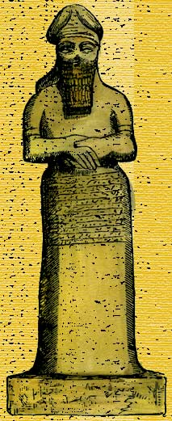
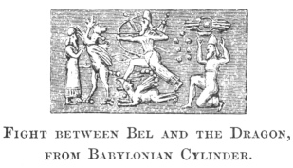
Question #4
The name changes described in 1:7—see any purpose behind these changes?
Nebo

Slide 12
Question #5
What “daily provision” did the king make for these trainees? (1:5).

Slide 13
Question #6
What did Daniel resolve or purpose in his heart? (1:8).
Do we know for sure why these “delicacies” would cause Daniel to defile himself?
“Ezra had prepared his heart to seek the law of the LORD, and to do it, and to teach statutes and ordinances in Israel” (Ezra 7:10).
Barnabas “encouraged them all that with purpose of heart they should continue with the Lord” (Acts 11:23).

Slide 14
Question #7
Whom did the chief of eunuchs fear? (1:10).
Whom did Daniel fear?
One man feared the lord Nebuchadnezzar; the other man feared Nebuchadnezzar’s Lord.

Slide 15
Question #8
What request did Daniel make of the steward—the one the chief of eunuchs had appointed over them, and did he honor the request? (1:11-14).
Who, in the N.T., was told they would be tested 10 days?
Answer found in Revelation 2:10.

Slide 16
Question #9
Did they “pass the test”? (1:15-16).

Slide 17
Question #10
When the chief of eunuchs brought them before the king, what did he determine about them? (1:18-20).
Note: “He found them ten times better than all the magicians and astrologers who were in all his realm” (1:20).

