Slide 1
Lesson 19
Ezekiel 33

Slide 2
Themes
“I’ve got some good news and some bad news.”
“Is their blood on my hands?”
“Toot your own horn.”
“Not fair, you say?”
“This land is (was) your land.”
“Play me another song.”

Slide 3
Questions
T F #1 Ezekiel continued to direct his message to the foreign nations.

Slide 4
Questions
Unto what did God liken Ezekiel’s responsibility?
“I have made you a watchman for the house of Israel…” (33:7).
Numbers 10:9 discusses the use of trumpets as a warning.
Two examples of watchmen warning the people: 2 Samuel 18:24-25; 2 Kings 9:17.
Who are the Lord’s watchmen today?

Slide 5
Questions
T F #2 The watchman is responsible for how his message is received.
But we are responsible for how it’s delivered, which can impact the manner in which it is received.

Slide 6
Questions
What is the condition of the watchman if he does NOT blow the trumpet? (33:6, 8).
“His blood I will require at your hand” (8).

Slide 7
Questions
What is his condition if he blows but the warning is unheeded? (33:3-5, 9).
Acts 20:26-27, 32: “Therefore I testify to you this day that I am innocent of the blood of all men. (27) “For I have not shunned to declare to you the whole counsel of God…(32) Therefore watch, and remember that for three years I did not cease to warn everyone night and day with tears.

Slide 8
Questions
T F #3 God has pleasure in the death of the wicked.

Slide 9
Questions
Why does God plead, “turn ye, turn ye from your evil ways”? (33:11, 14-16)
What does repentance sometimes involve? (15).

Slide 10
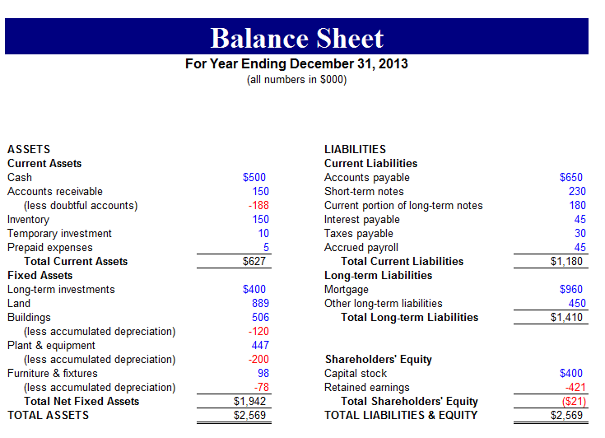
Questions
What could the righteous do that would cause him to die? (33:13, 18).

Slide 11
Questions
What did Israel say about God’s justice? (33:17, 20).
And the Lord’s answer to this charge?

Slide 12
Questions
T F #4 Ezekiel learned of Jerusalem’s fall in the 12th year, 10th month, 5th day.
Jer. 39:2 Had actually fallen in the 11th year, 4th month, 9th day (so Ezekiel gets word about 18 months later).
What happens here was predicted in 24:26-27.

Slide 13
Questions
Why did the remnant think the land was given to them for an inheritance? (33:23-24).
Occupation of the land, though, was always conditioned upon what?

Slide 14
Questions
What did God say they had done to lose the land? (33:25-26).

Slide 15
Questions
T F #5 The exiles acted as though they loved to hear Ezekiel.

Slide 16
Questions
How did God describe Israel’s “mouth” and “heart”? (33:31)

Slide 17
Questions
What was their reaction when they heard Ezekiel’s words? (33:32)

