Slide 1
Against Neighboring Nations (Ezekiel 25)
Against Ammon (25:1-7)
Against Moab (25:8-11)
Against Edom (25:12-14)
Against Philistia (25:15-17)

Slide 2
Against Tyre and Sidon (Ezekiel 26-28)
Destruction of Tyre (ch. 26)
Lamentation Over Tyre (ch. 27)
Judgment Against Tyre’s Prince (28:1-19)
Prophecy Against Sidon (28:20-26)

Slide 3
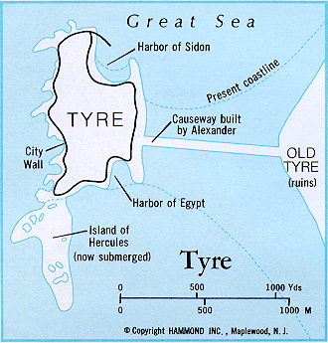
Against Tyre and Sidon (Ezekiel 26-28)
Destruction of Tyre (ch. 26)
Lamentation Over Tyre (ch. 27)
Judgment Against Tyre’s Prince (28:1-19)
Prophecy Against Sidon (28:20-26)

Slide 4
Against Egypt (Ezekiel 29-32)
Sins of Egypt (29:1-16)
Nebuchadnezzar the Instrument (29:17-21)
Judgment Speedy and Complete (30:1-19)
Arm of Pharaoh Will be Broken (30:20-26)
Egypt Will Fall Like a Great Cedar (ch. 31)
Lamentation for Pharaoh (32:1-16)
Burial of the King and His Subjects (32:17-32)

Slide 5
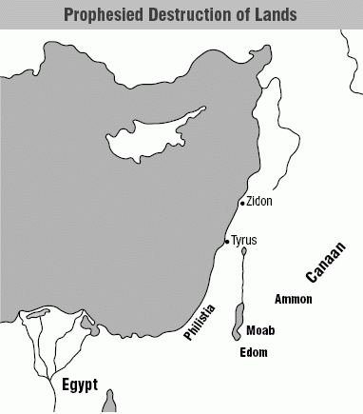
Against Egypt (Ezekiel 29-32)

Slide 6
“The word of the LORD came to me” (7x)
29:1 | 10th yr., 10th mo., 12th day | 587 B.C.
30:20 | 11th yr., 3rd mo., 7th day | 586 B.C.
31:1 | 11th yr., 3rd mo., 1st day | 586 B.C.
32:1 | 12th yr., 12th mo., 1st day | 585 B.C.
32:17 | 12th yr., 1st mo., 15th day | 585 B.C.
29:17 | 27th yr., 1st mo., 1st day | 570 B.C.
9th, 10th, 10th—Jerusalem besieged
11th, 4th, 9th—Jerusalem falls

Slide 7
29:17 | 27th yr., 1st mo., 1st day | 570 B.C.
Nebuchadnezzar besieged Tyre from 587-574 B.C. Did much harm to the mainland city, but because most inhabitants moved to the island fortress, he was not able to fully conquer Tyre (Alexander the Great did many years later in 332 B.C.). So “neither he nor his army received wages from Tyre, for the labor which they expended on it” (29:18).
“I will give the land of Egypt (as wages) to Nebuchadnezzar king of Babylon” (29:19).
Nebuchadnezzar invaded Egypt in 582 B.C. and then returned in 568 B.C., at which time he scattered the Egyptians to other lands.

Slide 8
Themes (Ezekiel 29-30)
“It’s all mine!”
“Lean on me”—NOT!
Destroy…scatter…restore
A gift for Nebuchadnezzar
“The day of the LORD is near”
“I’m having trouble holding this sword”

Slide 9
Themes (Ezekiel 29-30)
“It’s all mine!” (29:1-5)
What did Pharaoh Hophra (grandson of Necho) say?
How is he described in v. 3?
Jeremiah 44:30 also speaks of his demise.

Slide 10
Themes (Ezekiel 29-30)
“Lean on me”—NOT! (29:6-7)
“You have been a staff of _____ to the house of Israel” (29:6).
Even the Assyrian ambassador realized this: “Now look! You are trusting in the staff of this broken reed, Egypt, on which if a man leans, it will go into his hand and pierce it” (2 Kings 18:21).

Slide 11
Themes (Ezekiel 29-30)
Destroy…scatter…restore (29:8-16)
Unlike some of these other nations, who would “be no more,” what did God promise concerning Egypt (after they were scattered)?
Would they ever rise again to the prominence they once enjoyed?

Slide 12
Themes (Ezekiel 29-30)
A gift for Nebuchadnezzar (29:17-21)
He and his army expended great energy in efforts to defeat Tyre, but what did they NOT receive?
But they would get paid, right?

Slide 13
Themes (Ezekiel 29-30)
“The day of the LORD is near” (30:1-19)
Did this day of the LORD come for Egypt? What about for Moab, Edom, Ammon, etc.?
Will the final day of the Lord?
T F This “day”—this judgment—would affect just a small corner of Egypt.

Slide 14
Themes (Ezekiel 29-30)
“I’m having trouble holding this sword” (30:20-26)
What Pharaoh would be saying, but why?
Whose arms would God strengthen?

