Slide 1
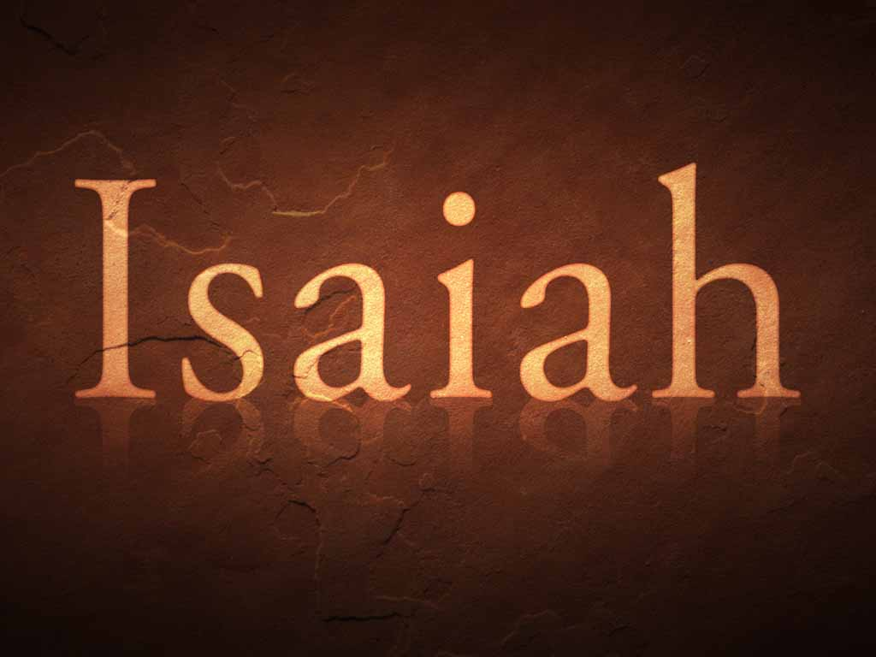
Isaiah

Slide 2
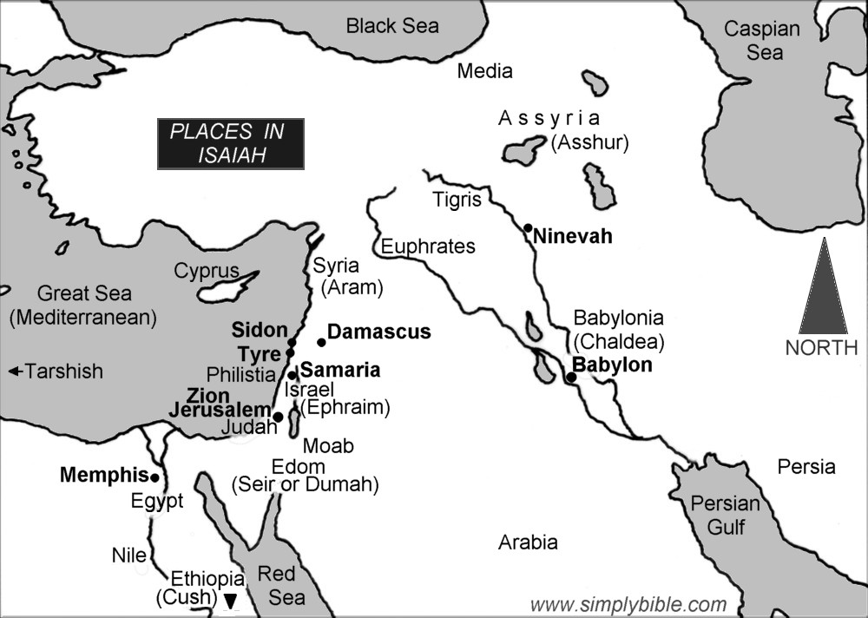

Slide 3
The Man
Name means “salvation of the Lord,” or “the Lord is salvation” (constant theme throughout the book).
Son of Amoz (1:1; 2:1; 13:1). Bible reveals nothing more of him; Jewish tradition says he was the brother of Amaziah, king of Judah.
Apparent from a number of references that he lived in Jerusalem.
Wife called a “prophetess” (8:3). Simply the wife of a prophet, or did she have the gift of prophecy?

Slide 4
The Man
At least two sons:
Shear-Jashub (7:3)—means “a remnant shall return” (Isaiah speaks often of this remnant).
Maher-Shalal-Hash-Baz (8:3)—means “speed the spoil, hasten the booty” (8:4 explains the meaning).
Tradition: executed (sawn in two) by Manasseh a few years after he began his reign.
Hebrews 11:37 an allusion to this death?

Slide 5
Time Frame
Prophesied from about 739 B.C. to 690 B.C., “in the days of Uzziah, Jotham, Ahaz, and Hezekiah, kings of Judah” (1:1).
“The year that King Uzziah died” (6:1) is used as the beginning point.
Historical background for this period can be found in 2 Kings 14-20 (Uzziah called Azariah in some references) and 2 Chronicles 26-32.

Slide 6
Conditions Before Isaiah’s prophecy
Isaiah grew up in the divided kingdom period, during the reigns of Uzziah, king of Judah, and Jeroboam II, king of Israel.
These were times of great affluence and prosperity, for both Israel and Judah (2 Kgs. 14:21-29; 2 Chron. 26).
Isaiah makes it clear they did NOT handle this prosperity very well. Isaiah preaches to both nations, but primarily to Judah.

Slide 7
Condition of Judah during this time
Threatened from within by its spiritual decay and moral corruption.
Threatened from without by Syria, Assyria, and the northern kingdom of Israel.
See bottom of p. 5 for four different Assyrian invasions into Israel, three of which are covered in Isaiah.
Northern kingdom of Israel taken into captivity by the Assyrians in 722/21 B. C.

Slide 8
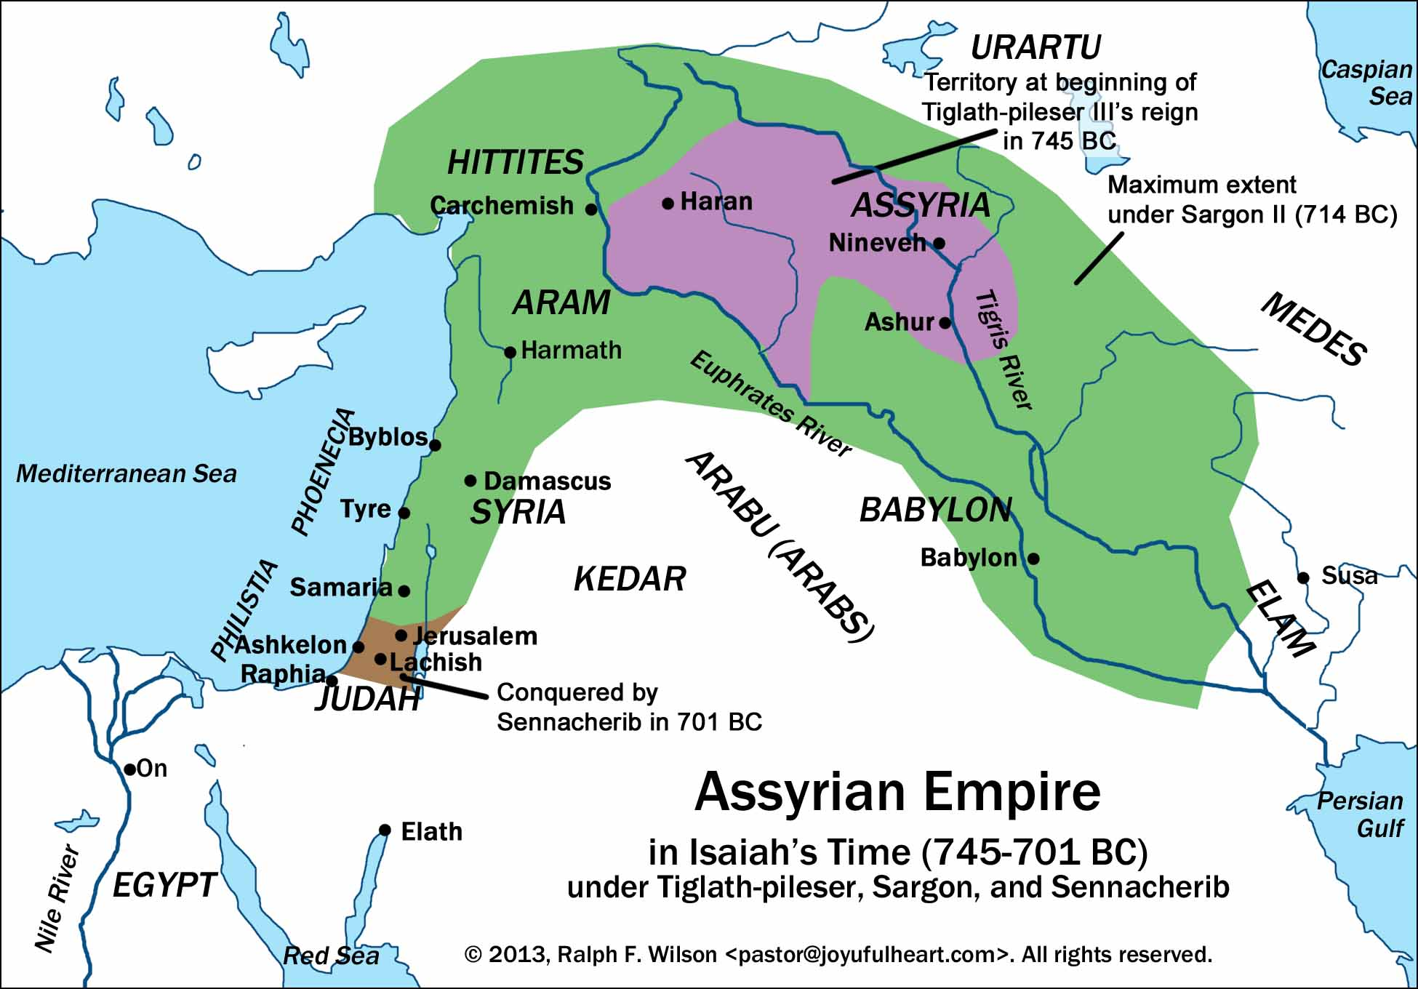

Slide 9
Contemporaries
Amos (760-750 B.C.), who prophesied to Israel, would have prophesied just shortly before Isaiah did.
Hosea (750-725 B.C.), who prophesied to Israel, would have overlapped Isaiah.
Micah (735 to 700 B.C.) prophesied to Judah, so his ministry coincided with Isaiah’s.

Slide 10
We will learn more about…
What it means to trust in the “Holy One of Israel” (Ahaz did not; Hezekiah did).
10:20; 12:1-2; 25:9; 26:3-4; 30:1-3; 30:18; 40:27-31.
Look for other passages that speak of relying, trusting, looking to, waiting on, etc.
God, both His character and His works.
“The LORD of hosts” (62x), meaning essentially the all powerful God.

Slide 11
We will learn more about…
God’s judgment against sin—not just against Israel and Judah, but all nations.
The true nature of sin—the affront to God that it truly is (watch for the various descriptions of sin, especially in the latter part of the book).
The comfort (18x) and peace (34x) God alone can provide.

Slide 12
We will learn more about…
The living God vv. idols (chs. 44-45 in particular)
“Look to Me, and be saved, all you ends of the earth! For I am God, and there is no other” (45:22).
The Messiah or the Christ, especially in His SERVANT role (esp., 49-50), and then as the suffering SERVANT (52-53).
The Messiah’s kingdom—its glory, and its inclusion of Gentiles (esp., 60-66).

