Slide 1
The Book of Acts

Slide 2
Acts Overview
28 Chapters in 26 Sundays
14 Chapters in April – June
14 Chapters in July – September
Lesson Format
Keys to This Chapter
Questions on the Text
Matching/True – False
Discussion Question

Slide 3
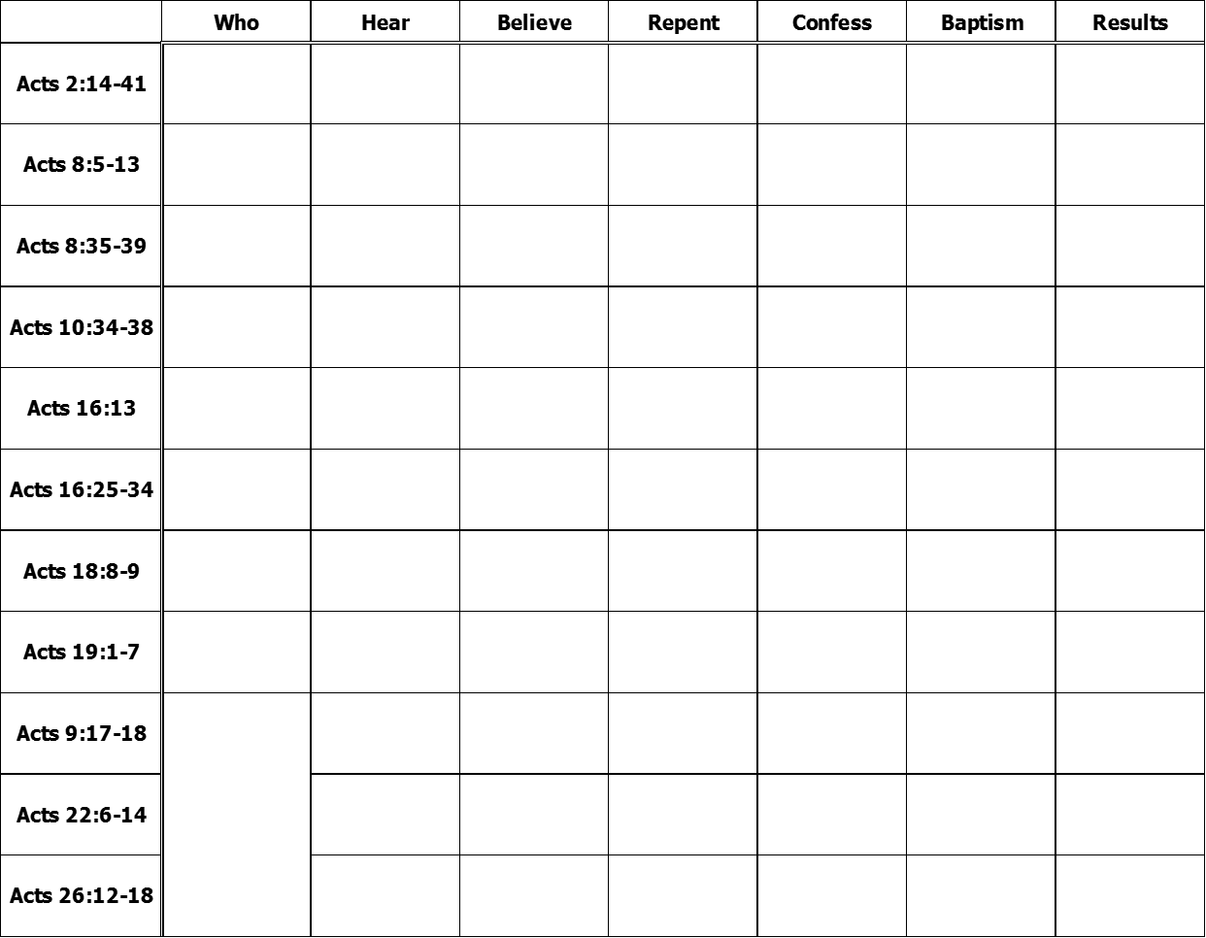

Slide 4
Acts Overview
Dates span: Before Pentecost to Paul in Rome. ( about 30 years)
Written before destruction of Jerusalem
Between 63AD and 70AD
Luke the Physician (the Historian)
Theophilus (many theories about him)
Acts 1:1 The former account?
Notes:
Dates Spanned
63AD to 70AD – Luke omits any reference to Rome’s destruction.
Luke the Historian. Luke is noted among secular historians for his accuracy in his documentation of events.
Use of “we” and “they”

Slide 5
Acts Overview
Luke 1:1 – 4 Inasmuch as many have taken in hand to set in order a narrative of those things which have been fulfilled among us, (2) just as those who from the beginning were eyewitnesses and ministers of the word delivered them to us, (3) it seemed good to me also, having had perfect understanding of all things from the very first, to write to you an orderly account, most excellent Theophilus, (4) that you may know the certainty of those things in which you were instructed.

Slide 6
Acts Overview
Dates span: Before Pentecost to Paul in Rome. ( about 30 years)
Written before destruction of Jerusalem
Between 63AD and 70AD
Luke the Physician (the Historian)
Theophilus (many theories about him)
The former account – all that Jesus did.
This account?
Notes:
Dates Spanned
63AD to 70AD – Luke omits any reference to Rome’s destruction.
Luke the Historian. Luke is noted among secular historians for his accuracy in his documentation of events.
Use of “we” and “they”

Slide 7
Acts Overview
The purpose of this account.
Historical
Defense
Biographical
Peter
Paul
Stephen
Philip
Barnabas
Timothy
Titus

Slide 8
Acts Overview
Five areas distinctly covered.
Apostolic work.
Holy Spirit work.
Teaching the gospel.
Conversions
Establishment and work of the church.

Slide 9
Acts 1
Q2 (v1 – 4)
Passover (14th day)
Thursday evening to Friday evening. (Passover meal through Burial.)
Lev 23:5 On the fourteenth day of the first month at twilight is the LORD's Passover.

Slide 10
Acts 1
Q2 (v1 – 4)
Feast of Unleavened Bread (15th day)
Friday evening to Saturday evening.
Lev 23:6 And on the fifteenth day of the same month is the Feast of Unleavened Bread to the LORD; seven days you must eat unleavened bread.

Slide 11
Acts 1
Q2 (v1 – 4)
Feast of First Fruits (16th day)
Saturday evening to Sunday evening
Lev 23:10-11 "Speak to the children of Israel, and say to them: 'When you come into the land which I give to you, and reap its harvest, then you shall bring a sheaf of the firstfruits of your harvest to the priest. (11) He shall wave the sheaf before the LORD, to be accepted on your behalf; on the day after the Sabbath the priest shall wave it.

Slide 12
Acts 1
Q2 (v1 – 4)
50 Days later…
Lev 23:15-16 'And you shall count for yourselves from the day after the Sabbath, from the day that you brought the sheaf of the wave offering: seven Sabbaths shall be completed. (16) Count fifty days to the day after the seventh Sabbath; then you shall offer a new grain offering to the LORD.

Slide 13
Acts 1
Q2 (v1 – 4)
50 Days later…
Feast of Weeks
Pentecost – 50th day
pentekoste – Greek
pentecoste – Latin
Pentagon

Slide 14
Acts 1
Q3 – 5 (v4 – 8)
Wait in Jerusalem.
Isa 2:3 Many people shall come and say, "Come, and let us go up to the mountain of the LORD, To the house of the God of Jacob; He will teach us His ways, And we shall walk in His paths." For out of Zion shall go forth the law, And the word of the LORD from Jerusalem.

Slide 15
Acts 1
Q3 – 5 (v4 – 8)
The Baptism of the Holy Spirit.
John 14:16 And I will pray the Father, and He will give you another Helper, that He may abide with you forever—

Slide 16
Acts 1
John 16:7, 12 – 13 Nevertheless I tell you the truth. It is to your advantage that I go away; for if I do not go away, the Helper will not come to you; but if I depart, I will send Him to you. …(12) "I still have many things to say to you, but you cannot bear them now. (13) However, when He, the Spirit of truth, has come, He will guide you into all truth; for He will not speak on His own authority, but whatever He hears He will speak; and He will tell you things to come.

Slide 17
Acts 1
Q3 – 5 (v4 – 8)
The are still looking for an alternative to the Roman government. (v6)
Not a yes or no answer, but rather here is what is going to happen.
How will they get this question answered? (v8)

Slide 18
Acts 1
Q6 – 8 (v9 – 14)
Ascension of Christ
He’ll return in the same manner.
They have been told to wait. They spent their time in prayer.
Peter reminds all of Judas betrayal.
Luke fills in the details.

Slide 19
Acts 1
Q6 – 8 (v9 – 14)
Acts 1:18 Now this man purchased a field.
Matt 27:5 Then he threw down the pieces of silver in the temple and departed, and went and hanged himself.
Mat 27:6-7 But the chief priests took the silver pieces… and bought with them the potter's field, to bury strangers in.

Slide 20
Acts 1
Q9 – 12 (v15 – 26)
Peter is the one who speaks up about the need to replace Judas.
How many disciples?
About 120

Slide 21
Acts 1
Q9 – 12 (v15 – 26)
Two scriptures cited by Peter
Psa 69:25 Let their dwelling place be desolate; Let no one live in their tents.
Psa 109:8 Let his days be few, And let another take his office.
Peter formed a conclusion from scripture about what needed to be done.

Slide 22
Acts 1
Q9 – 12 (v15 – 26)
The qualifications:
Eyewitness of Christ
From the baptism of John to the ascension of Jesus
Decision making by committee.
Prayer

Slide 23
The Book of Acts

Slide 24
Acts 2
Q1 – 2 (v1 – 4)
On what day?
Pentacost (v1) – Feast of Weeks – 7 weeks + 1 day from…
Feast of First Fruits (Lev 23:10–11)
Feast of Unleavened Bread (Lev 23:6)
Passover (Lev 23:5)

Slide 25
Acts 2
Q1 – 2 (v1 – 4)
1st day of the week (Pentacost)
“They were all with one accord (together ESV)” They?
Descriptive terms in use.
Sound like wind – not windy
Tongues like fire – not on fire.

Slide 26
Acts 2
Q1 – 2 (v1 – 4)
What did the sound and tongues accomplish?
What was the visible accomplishment of the Holy Spirit?
Visible confirmation by witnesses that these men have an authority from God.

Slide 27
Acts 2
Q3 – 5 (v5 – 13)
Devout Jews from every nation
Men from Galilee speaking in the languages of the nations there.
What was being said?
“The wonderful works of God” (v11)
Scoffers thought they are drunk.

Slide 28
Acts 2
Q6 – 11 (v14 – 36) – Peter’s Sermon
They aren’t drunk, it’s the fulfillment of the prophecy of Joel. (Joel 2:28 – 32)
Main point of sermon?
v36 This Jesus… is both Lord and Christ.
Reasons why…

Slide 29
Acts 2
Seven reasons Jesus… is both Lord and Christ. (to know assuredly) v36
Attested by God (v22)
Purposed by God (v23)
Raised by God (v24)
Promised by God (v25 – 31)
Witnessed by men (v32)
Exalted by God (v33-35)
Confirmed by the Holy Spirit (v33)

Slide 30
Acts 2
Q12 – 15 (v37 – 47)
“What shall we do?” What is being asked for?
Mercy, Forgiveness, a Remedy.
Repent and be baptized in the name of Jesus Christ.
For the remission of sins
Receive the gift of the Holy Spirit.

Slide 31
Acts 2
Q12 – 15 (v37 – 47)
“…shall receive the gift of the Holy Spirit”
Baptism of Holy Spirit?
Performing miracles?
Influenced by the Holy Spirit?
Allowed to change their desires/attitude
Allowed to dwell in them (1 Cor 6:19)

Slide 32
Acts 2
Q12 – 15 (v37 – 47)
About 3000 baptized - continued steadfastly:
Apostles doctrine
Fellowship
Breaking of bread
Prayers
Sold possessions to support themselves in Jerusalem
Happy people

Slide 33
Acts 2
Who:
Hear:
Believe:
Repent:
Confess:
Baptized:
Result:
Jews in Jerusalem (v5 & 14)
Peter Preached (v14 – 38)
Cut to the heart (v37)
Command (v38)
Command (v38) Done (v41)
v42 – 47

Slide 34
The Book of Acts

Slide 35
Acts Review
Baptism of the Holy Spirit.
Preaching on the day of Pentecost.
Addition of 3000
Lame man healed at the gate of the Temple.
Preaching at Solomon’s Porch at the temple.

Slide 36
Acts 4
Q1 – 2 (v1 – 4)
Priests, Captain of the Temple, Sadducees.
Sadducees – Sect of the Jews that believed there is not a resurrection.
Peter and John held over night.
The number of believing men is about 5000.

Slide 37
Acts 4
Q3 – 6 (v5 – 12)
Annas and Caiaphas
John 18:13–28

Slide 38
Acts 4
Q3 – 6 (v5 – 12)
Roman appointed High Priests
Annas (son of Seth) 6–15AD
Ishmael (son of Fabus) 15–16AD
Eleazar (son of Annas) 16–17AD
Caiaphas (son-in-law to Annas) 18–36AD
Who previously stood where Peter stands?

Slide 39
Acts 4
Q3 – 6 (v5 – 12)
Annas and Caiaphas
John 18:13–28
Peter is now standing where Jesus stood.
“By what power or name have you done this?”
What did they NOT ask about?

Slide 40
Acts 4
Q3 – 5 (v5 – 12)
Peter’s answer…
Addresses what is asked:
“by the name of Jesus Christ” (v10)
Addresses what is NOT asked
“a good deed done” – the miracle (v9)
“whom God raised from the dead” (v10)

Slide 41
Acts 4
Q3 – 6 (v5 – 12)
Peter’s answer…
Accusers become the accused. (v11)
Matt 21:23 Now when He came into the temple, the chief priests and the elders of the people confronted Him as He was teaching, and said, "By what authority are You doing these things? And who gave You this authority?"

Slide 42
Acts 4
Q3 – 6 (v5 – 12)
Peter’s answer…
Accusers become the accused. (v11)
Mat 21:42 Jesus said to them, “Have you never read in the Scriptures: ‘The stone which the builders rejected Has become the chief cornerstone. This was the Lord’s doing, And it is marvelous in our eyes’?
Quoting Psalms 118:22

Slide 43
Acts 4
Q3 – 6 (v5 – 12)
Peter’s answer…
Acts 4:12 And there is salvation in no one else, for there is no other name under heaven given among men by which we must be saved."
Notes:
Nor is there salvation in any other (this would include the council that he is speaking to)

Slide 44
Acts 4
Q7 – 8 (v13 – 22)
What a dilemma…
Uneducated, untrained men have bested them.
The healed man stood before them.
They couldn’t deny the miracle which confirmed the power of God.
No charge of blasphemy could be levied.

Slide 45
Acts 4
Q7 – 8 (v13 – 22)
Who did the council fear?
The people – “so that it spreads no further among the people”
Loss of power
Loss of privilege
Loss of Roman support.

Slide 46
Acts 4
Q7 – 8 (v13 – 22)
Warned: “Speak no more to anyone in this name.”
Peter asks:
Acts 4:19 But Peter and John answered them, "Whether it is right in the sight of God to listen to you rather than to God, you must judge,

Slide 47
Acts 4
Q9 (v23 – 31)
What next for the apostles?
Determined to continue
Prayer
Who they are up against. (v26-28)
Request for boldness (v29)
Request for support (v30)
Confirmation (v31)

Slide 48
Acts 4
Q10 (v32 – 37)
The saints supported one another.
The apostles continued to teach the resurrection.
Introduction to Barnabas (son of encouragement)

Slide 49
The Book of Acts

Slide 50
Acts Review
Baptism of the Holy Spirit.
Preaching on the day of Pentecost.
Addition of 3000
Lame man healed at the gate of the Temple.
Preaching at Solomon’s Porch at the temple. (total men now 5000)

Slide 51
Acts Review
Sadducees\High Priests in fear of:
Loss of power
Loss of privilege (money, life style)
Loss of Roman support
Peter & John spent the night in jail.
Sternly commanded to stop preaching.
Chapter 5 – Conflict will escalate

Slide 52
Acts 5
Q1 – 2 (v1 – 11)
What circumstance compelled Ananias & Sapphira to sell their land?
Jewish Christians haven’t left Jerusalem as they normally would have after the feasts.
See Acts 4:32-37
The sin was to be deceitful about the gift. Lie to (v3) or test (v9) the Spirit.

Slide 53
Acts 5
Q1 – 2 (v1 – 11)
Was this a miracle?
Negative miracle – Did it have positive results?
Church discipline?
Is it negative?
Is it positive?

Slide 54
Acts 5
Q3 – 6 (v12 – 21)
Back at Solomon’s porch
Performing miracles regularly
None of the rest dared join (v13)
The people held them in high esteem. (v13)
More than ever believers were added to the Lord. (v14)
Large efforts made to be healed. (v15)
They were all healed (v16) From how far?

Slide 55
Acts 5
Q3 – 6 (v12 – 21)
What authority figure at the temple was not healing people?
Filled with indignation (jealousy [ESV]), the high priest and Sadducees had them arrested. (v17 – 18)
An Angel released them during the night.
Where did they go?

Slide 56
Acts 5
Q3 – 6 (v12 – 21)
Two charges:
Charge of High Priest
Acts 4:18 So they called them and commanded them not to speak at all nor teach in the name of Jesus.
Charge of God
Acts 5:20 "Go, stand in the temple and speak to the people all the words of this life."

Slide 57
Acts 5
Q7 – 8 (v22 – 32)
How did they get Peter and John? (v26)
Accusation:
Do not teach in this name. (v28)
You have filled Jerusalem with your doctrine.
Intend to bring this Man’s blood on us. (Matt 27:25 – 26)
Peter & John’s goal? Acts 2:36 – 38

Slide 58
Acts 5
Q7 – 8 (v22 – 32)
Peter’s defense/sermon
We ought to obey God rather than men. (v29)
Jesus is:
The one crucified but raised by God (v30)
The one humiliated but exalted by God (v31)
The one rejected but made the Savior by God (v31)

Slide 59
Acts 5
Q7 – 8 (v22 – 32)
Peter’s defense/sermon
We ought to obey God rather than men. (v29)
Jesus is: raised, exalted, the Savior
We witnessed. (v32)
Holy Spirit confirmed. (v32)

Slide 60
Acts 5
Q9 – 12 (v33 – 42)
Last Time:
Acts 4:21 So when they had further threatened them, they let them go, finding no way of punishing them, because of the people, since they all glorified God for what had been done.
This Time:
Acts 5:33 When they heard this, they were furious and plotted to kill them.
Notes:
Gamaliel (guh-MAY-lih-ehl)

Slide 61
Acts 5
Q9 – 12 (v33 – 42)
Wisdom of Gamaliel
Acts 22:3
Instead of killing, they beat Peter and John (v40)
Acts 5:41-42 So they departed from the presence of the council, rejoicing that they were counted worthy to suffer shame for His name. (42) And daily in the temple, and in every house, they did not cease teaching and preaching Jesus as the Christ.
Notes:
Gamaliel (guh-MAY-lih-ehl)

Slide 62
The Book of Acts

Slide 63
Acts Review
Baptism of the Holy Spirit.
Preaching on the day of Pentecost.
Addition of 3000
Lame man healed at the gate of the Temple.
Preaching at Solomon’s Porch at the temple. (total men now 5000)

Slide 64
Acts Review
Sadducees\High Priests in fear of:
Loss of power
Loss of privilege (money, life style)
Loss of Roman support
Peter & John jailed and sternly commanded to stop preaching.
Peter & John jailed, released by Angel, then beaten.

Slide 65
Acts 6
Q2 – 6 (v1 – 7)
Problem summary
Hellenists (Greek speaking Jews)
Their widows are neglected in the daily distribution (physical needs).
The 12 (apostles) needed to focus on the distribution of the word of God (spiritual needs).

Slide 66
Acts 6
Q2 – 6 (v1 – 6)
Solution to physical needs:
Appoint men to be responsible for this need.
The 12 set the qualifications. (v3)
The members put forth the men. (v5 – 6)
The 12 appointed the seven. (v6)

Slide 67
Acts 6
Q8 – 10 (v7 – 15)
Effect on church
Chapter 5 – Church Discipline
Great fear… believers were increasingly added. (5:11 – 14)
Chapter 6 – Church Benevolence
The word of God spread… the number multiplied… a great many of the priests were obedient. (6:7)

Slide 68
Acts 6
Q8 – 10 (v7 – 15)
Charge against Stephen
Remember they weren’t able to bring a charge of blasphemy against Peter & John.
The hired men to make sure they could.
Specifically:
Jesus will destroy the temple.
Change the law of Moses.

Slide 69
Acts 7
Q4, 7, 9, & 10 (v1 – 60)
Stephen’s defense/sermon:
Abraham’s descendants are in a covenant of circumcision with God. (v2 – 8) Gen 17
God rescues Israel. (v9 – 36)
Israel rejects God (v37 – 45)
God doesn’t dwell in a man made temple. (v44 – 50) Isa 66:1 – 2
Israel rejects God (v51 – 53)

Slide 70
Acts 7
Q4, 7, 9, & 10 (v1 – 60)
Rebukes them…
using their own history.
in their claim to the temple. (v48)
in their rejection of Christ. (v52)
Stiff necked and uncircumcised in heart and ears. (v51)

Slide 71
Acts 7
Q4, 7, 9, & 10 (v1 – 60)
Plugged their ears, ran at him, stoned him outside the city (v57-58)
5:17 “filled with indignation”
5:24 “wondered what the outcome would be”
5:33 “were furious and plotted to kill them”
6:54 “gnashed at him with their teeth”

Slide 72
Acts 7
Q4, 7, 9, & 10 (v1 – 60)
Stephen sees Jesus in a vision (v55)
Who held the coats?
Acts 17:24
Paul makes the same argument from Isaiah 66:1-2

Slide 73
The Book of Acts

Slide 74
Acts Review
Baptism of the Holy Spirit.
Preaching on the day of Pentecost.
Preaching at Solomon’s Porch at the temple. (total men now 5000)
Sadducees\High Priests in fear of:
Loss of power
Loss of privilege (money, life style)
Loss of Roman support

Slide 75
Acts Review
Peter & John jailed and sternly commanded to stop preaching.
Peter & John jailed, released by Angel, then beaten.
Stephen stoned.
All took place in Jerusalem.

Slide 76
Acts 8
Q1 – 4 (v1 – 8)
Turning point in history – The persecution of the church.
Saul’s persecution of the church was brutal.
“havoc” (ESV “ravaging”) – men & women put in prison.
What good came from the persecution?

Slide 77
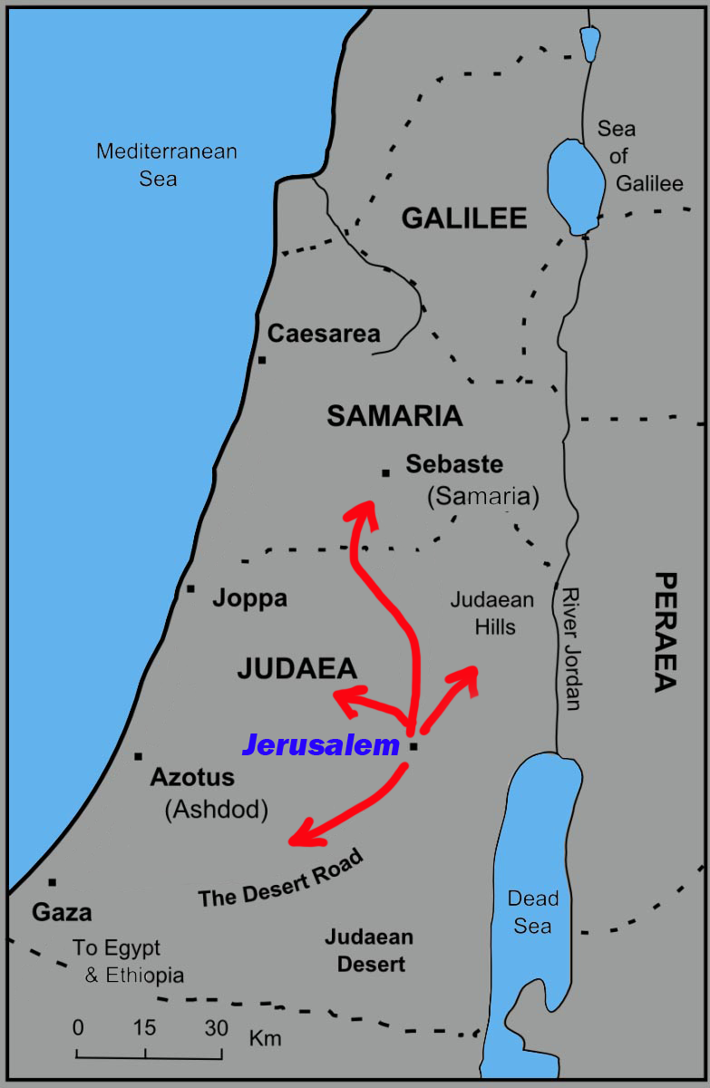
Acts 8
Q1 – 4 (v1 – 8)
Church Scattered
Judea & Samaria
Philip traveled to the city of Samaria
Multitudes heeded the gospel. (v6)
Great joy (v8)

Slide 78
Acts 8
Q5 – 9 (v9 – 25)
Simon
Believed & was baptized (v13)
Simon sinned
Remedy?
Acts 2:37 “What shall we do?”
Remedy?
Why is it different?

Slide 79
Acts 8
Q5 – 9 (v9 – 25)
How was Philip able to do miracles?
Acts 6: 5 – 8
Why did Peter and John need to come to Samaria?
Acts 8: 14 – 15
How was the Holy Spirit given?
Acts 8: 15 – 17

Slide 80
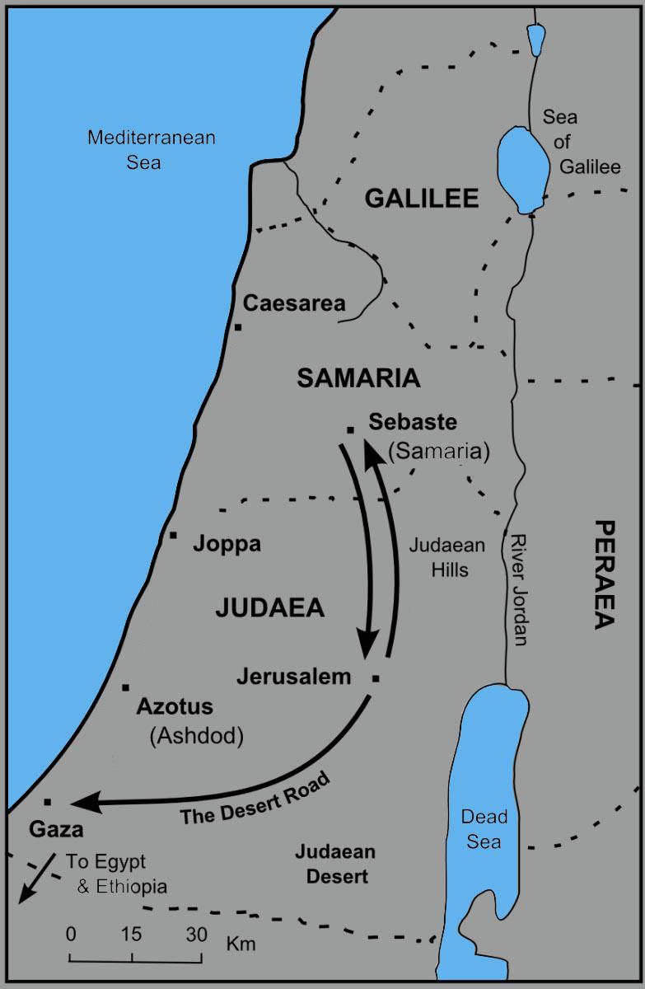
Acts 8
Q10 – 15 (v26 – 40)
Divine Instruction: Go to a desert road – Jerusalem to Gaza
Meets the treasurer of the Ethiopian Queen.
“Candace” is a title like “Pharaoh”.

Slide 81
Acts 8
Q10 – 15 (v26 – 40)
Ethiopian served the true God (v27)
Second divine instruction. “Go near and overtake this chariot.” (v29)
Isaiah 53:7 – Passage about the Lamb of God.

Slide 82
Acts 8
Q10 – 15 (v26 – 40)
Ethiopian’s conversion:
Heard the gospel of Christ (v35)
Believed the gospel of Christ (v36 – 37)
Confessed the name of Christ (v37)
Baptized into Christ (v38)
From this passage, why would this be immersion?

Slide 83
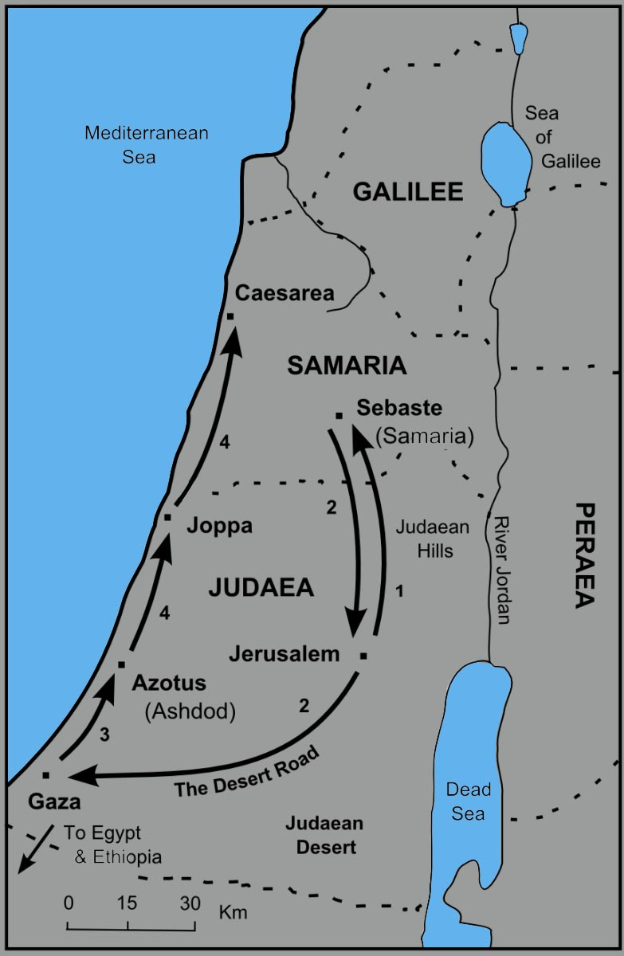
Acts 8
Q10 – 15 (v26 – 40)
Ethiopian went on his way rejoicing.
Philip found at Azotus and preached in cities till he came to Caesarea

Slide 84
v14
v5-9
v27

Slide 85
The Book of Acts

Slide 86
Acts 9
Q1 – 6 (v1 – 19)
Acts 8:3 As for Saul, he made havoc of the church, entering every house, and dragging off men and women, committing them to prison.
Still breathing threats and murder…
Continual activity
Jerusalem to Damascus

Slide 87
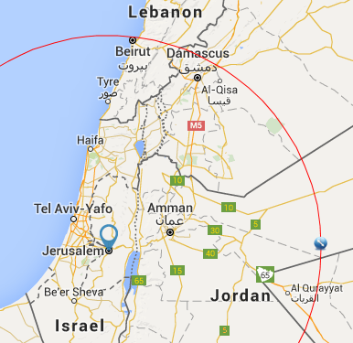
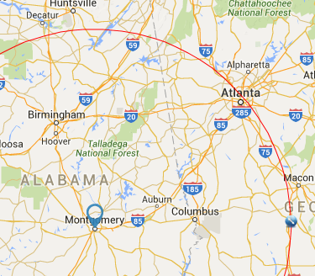
150 Miles
2 weeks

Slide 88
Acts 9
Q1 – 6 (v1 – 19)
The Way – 1st of 8 times mentioned in Acts.
John 14:6 Jesus said to him, "I am the way, the truth, and the life. No one comes to the Father except through Me.
As in Chapter 8, Saul is indiscriminant taking men and women captive.

Slide 89
Acts 9
Q1 – 6 (v1 – 19)
Near Damascus…
A sudden light shone from heaven.
“Saul, Saul, why are you persecuting me.” (v4)
“I am Jesus, whom you are persecuting. It is hard for you to kick against the goads.” (v5)

Slide 90
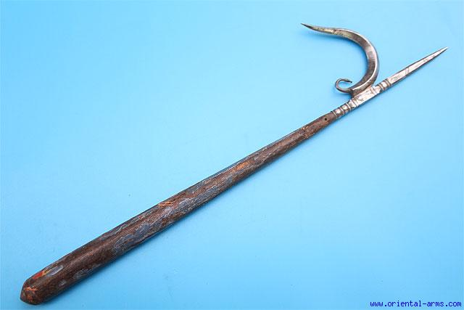
Acts 9
Q1 – 6 (v1 – 19)
Near Damascus…
A sudden light shone from heaven.
“Saul, Saul, why are you persecuting me.” (v4)
“I am Jesus, whom you are persecuting. It is hard for you to kick against the goads.” (v5)

Slide 91
Acts 9
Q1 – 6 (v1 – 19)
Near Damascus…
A sudden light shone from heaven.
“Saul, Saul, why are you persecuting me.” (v4)
“I am Jesus, whom you are persecuting. It is hard for you to kick against the goads.” (v5)
“Arise and go into the city, and you will be told what you must do.” (v6)

Slide 92
Acts 9
Q1 – 6 (v1 – 19)
At Damascus…
Saul is 3 days with sight, food, or drink but praying at the house of Judas.
Ananias is told by the Lord to go to him to restore his sight. (v10-15)
Ananias said “that you might receive your sight and be filled with the Holy Spirit”. (v17)

Slide 93
Acts 9
Q1 – 6 (v1 – 19)
At Damascus…
Saul’s sight was restore and he was baptized.
Why was Saul selected by the Lord? (v15-16)
Gentiles
Kings
Children of Israel

Slide 94
Acts 9
Q7 – 12 (v20 – 31)
Saul preached in the synagogues. (v20)
People were amazed (v21)
Saul confounded (perplexed) the Jews.
“Now after many days were past,” (v23)
Gal 1:17-18 (3 years)
Jews plotted to kill him, he escaped and went to Jerusalem. (v26)

Slide 95
Acts 9
Q7 – 12 (v20 – 31)
Saul not accepted due to reputation. (v26)
Barnabas willing to vouch for him. (v27)
Again, the Jews attempt to kill Saul. (v29)
Saul goes to Caesarea and then to Tarsus. (v30)
The churches had peace, were edified, & multiplied. (v31)

Slide 96
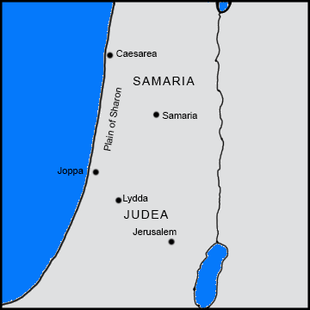
Acts 9
Q13 – 15 (v32 – 43)
Peter –
All parts of the country (v32)
Lydda (v35)
Joppa (v36)
Sharon (v35)

Slide 97
Acts 9
Q13 – 15 (v32 – 43)
Aeneas in Lydda
Tabitha (Dorcus) in Joppa
Lydda – “all who dwelt in Lydda and Sharon… turned to the Lord.” (v35)
Joppa – “many believed on the Lord” (v42)

Slide 98
v14
v5-9
v27
Paul

Slide 99
The Book of Acts

Slide 100
Acts Review
In Jerusalem:
Baptism of the Holy Spirit.
Preaching on the day of Pentecost.
Preaching at the temple.
Sadducees\High Priests fear loss.
Peter & John jailed twice, beaten once.
Stephen is stoned.
Christians number in the many thousands including many priests who are converted.

Slide 101
Acts Review
Out of Jerusalem:
Persecution of the church. Saul was a key figure. Christians leave Jerusalem.
Philip preached
in Samaria and on the road to Gaza
Cities from Azotus to Caesarea
Lydda and Joppa
Saul meets Jesus – the road to Damascus.
Ananias teaches Saul in Damascus.

Slide 102
Acts 10
Q1 – 5 (v1 – 23)
Caesarea
Joppa

Slide 103
Acts 10
Q1 – 5 (v1 – 23)
Cornelius
Centurion (over one hundred men)
Spiritual:
Devout
Feared God
Gave generously
Prayed always

Slide 104
Acts 10
Q1 – 5 (v1 – 23)
Patriarchal
Christian
Mosaical

Slide 105
Acts 10
Q1 – 5 (v1 – 23)
Patriarchal
Christian
Dispensation – A method of giving God’s will.
Dispenser – releases/delivers something.
Mosaical

Slide 106
Acts 10
Q1 – 5 (v1 – 23)
Patriarchal
Christian
Heb 1:1-2 God, who at various times and in various ways spoke in time past to the fathers by the prophets, (2) has in these last days spoken to us by His Son, whom He has appointed heir of all things, through whom also He made the worlds;
Mosaical

Slide 107
Acts 10
Q1 – 5 (v1 – 23)
God holds all nations accountable:
Isaiah 13:1 – Babylon
Isaiah 14:24 – Assyria
Isaiah 14:28 – Philistia
Isaiah 15:1 – Moab
Isaiah 19:1 – Egypt
Isaiah 21:13 – Arabia
Many others in Isaiah

Slide 108
Acts 10
Q1 – 5 (v1 – 23)
Cornelius sends 2 household servants and a soldier to Joppa. ( ≈ 30 miles)
The next day, Peter is praying on the housetop. 6th hour is about Noon.
The vision of the animals on a sheet is presented 3 times.

Slide 109
Acts 10
Q1 – 5 (v1 – 23)
Peter ponders the vision and the men arrive.
Spirit commands Peter to go with them.
The next day (3rd Day) Peter, some Joppa brethren, and 3 from Cornelius leave for Caesarea.
The following day (4th day) arrived.

Slide 110
Acts 10
Q6 – 10 (v24 – 43)
Cornelius is waiting for them.
Called together family and close friends.
Honors Peter, a Jewish man.
Peter starts with the obvious: This isn’t normal.
BUT, God has shown me… (v28)

Slide 111
Acts 10
Q6 – 10 (v24 – 43)
Cornelius explains to Peter and says:
“Now therefore, we are all present before God, to hear all the things commanded you by God.“ (v33)
Does a good man need salvation?
Peter’s first statement? (v34)
“In truth I perceive that God shows no partiality.”

Slide 112
Acts 10
Q6 – 10 (v24 – 43)
Peter’s lesson was about…
Christ
Baptism
Death of Christ
Resurrection of Christ
Remission of sins.

Slide 113
Acts 10
Q11 – 15 (v44 – 48)
Holy Spirit fell upon all those who heard.
Spoke in tongues
Magnified God
Where else has this happen?
Acts 10:47 "Can anyone forbid water, that these should not be baptized who have received the Holy Spirit just as we have?"
How was Peter honored now?

Slide 114
v14
v5-9
v27
v24
Paul

Slide 115
The Book of Acts

Slide 116
Acts Review
In Jerusalem:
Baptism of the Holy Spirit.
Preaching on the day of Pentecost.
Preaching at the temple.
Sadducees\High Priests fear loss.
Peter & John jailed twice, beaten once.
Stephen is stoned.
Christians number in the many thousands including many priests who are converted.

Slide 117
Acts Review
Out of Jerusalem:
Persecution of the church. Saul was a key figure. Christians leave Jerusalem.
Philip preached in Samaria and the plain of Sharon from Azotus to Caesarea.
Ethiopian converted by Philip.
Saul converted in Damascus.
Cornelius and household converted.
The gospel spreads geographically and outside the Jewish nation.

Slide 118
Acts 11
Q1 – 6 (v1 – 18)
Peter confronted by Jewish Christians
Peter recounts the events.
We learn the men from Joppa number 6.
They serve as witnesses of the events.
Peter and others must reason out the application from the events. (v16 – 18)

Slide 119
Acts 11
Q7 – 11 (v19 – 26)
Acts 8:1 Now Saul was consenting to his death. At that time a great persecution arose against the church which was at Jerusalem; and they were all scattered throughout the regions of Judea and Samaria, except the apostles.

Slide 120
Acts 11
Q7 – 11 (v19 – 26)
Acts 11:19-20 Now those who were scattered after the persecution that arose over Stephen traveled as far as Phoenicia, Cyprus, and Antioch, preaching the word to no one but the Jews only. (20) But some of them were men from Cyprus and Cyrene, who, when they had come to Antioch, spoke to the Hellenists, preaching the Lord Jesus.

Slide 121
Acts 11
Q7 – 11 (v19 – 26)
Acts 11:19-20 Now those who were scattered after the persecution that arose over Stephen traveled as far as Phoenicia, Cyprus, and Antioch, preaching the word to no one but the Jews only. (20) But some of them were men from Cyprus and Cyrene, who, when they had come to Antioch, spoke to the Hellenists, preaching the Lord Jesus.

Slide 122
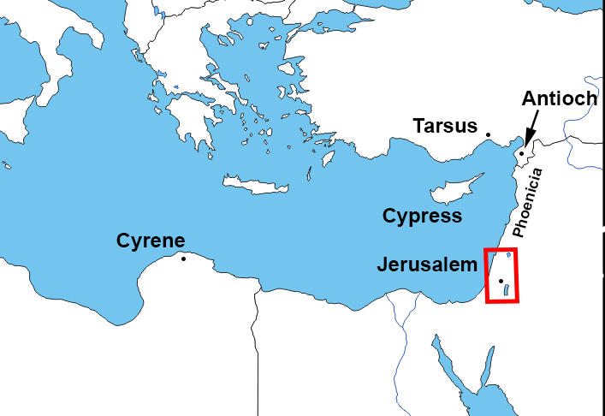
Acts 11

Slide 123
Acts 11
Q7 – 11 (v19 – 26)
Acts 11:19-20 Now those who were scattered after the persecution that arose over Stephen traveled as far as Phoenicia, Cyprus, and Antioch, preaching the word to no one but the Jews only. (20) But some of them were men from Cyprus and Cyrene, who, when they had come to Antioch, spoke to the Hellenists, preaching the Lord Jesus.

Slide 124
Acts 11
Q7 – 11 (v19 – 26)
Antioch of Syria
Population of over 500,000, including a Jewish colony of 70,000.
Thriving economy because of its strategic position at the crossroads of trade routes south to Palestine and Egypt, east to Persia and west to the Asia Minor peninsula.
Josephus ranked it as the third greatest city of the Roman Empire, behind Rome and Alexandria.

Slide 125
Acts 11
Q7 – 11 (v19 – 26)
Barnabus sent by Jerusalem
“had seen the grace of God” (v23) ?
Grace – getting what is not deserved.
Mercy – not getting what is deserved.
Why would Barnabus think Saul would be helpful?

Slide 126
Acts 11
Q12 – 15 (v27 – 30)
Prophet from Jerusalem – Agabus.
Great famine
Claudis Ceasar – 41 to 54 AD
Nero will follow Claudis
Send relief (benevolence)
To the elders
By Barnabus and Saul

Slide 127
Timeline of Acts

Slide 128
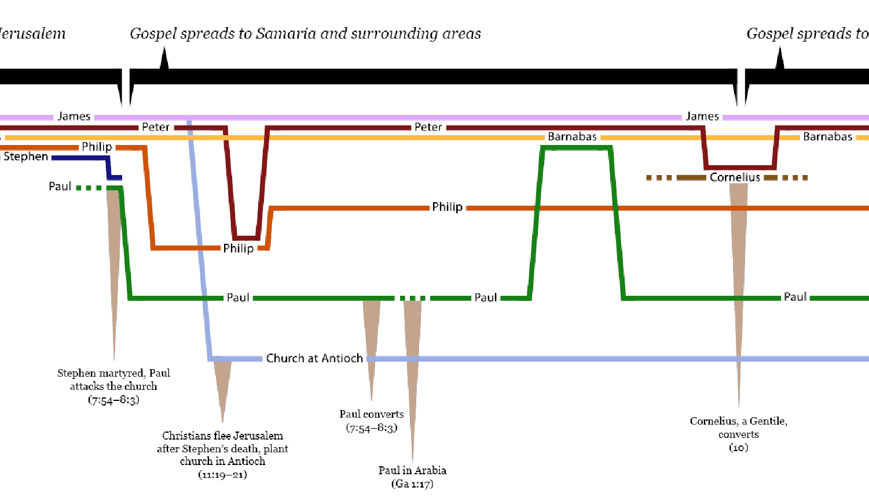
http://overviewbible.com/wp-content/uploads/2014/07/acts-timeline1.png
This should be used carefully and checked for accuracy. No endorsement is given of the content of this resource.

Slide 129
The Book of Acts

Slide 130
Acts 13
Q1 – 7 (v1 – 12)
Holy Spirit selection
“for the work to which I have called them.” (v2)
Fasted, Prayed, Laid hands on them
Dedication of things to Divine Service

Slide 131
Acts 13
Q1 – 7 (v1 – 12)
Exo 29:10 "You shall also have the bull brought before the tabernacle of meeting, and Aaron and his sons shall put their hands on the head of the bull.

Slide 132
Acts 13
Q1 – 7 (v1 – 12)
Lev 1:4 Then he shall put his hand on the head of the burnt offering, and it will be accepted on his behalf to make atonement for him.

Slide 133
Acts 13
Q1 – 7 (v1 – 12)
Num 8:9-11 And you shall bring the Levites before the tabernacle of meeting, and you shall gather together the whole congregation of the children of Israel. (10) So you shall bring the Levites before the LORD, and the children of Israel shall lay their hands on the Levites; (11) and Aaron shall offer the Levites before the LORD like a wave offering from the children of Israel, that they may perform the work of the LORD.

Slide 134
Acts 13
Q1 – 7 (v1 – 12)
Holy Spirit selection
“for the work to which I have called them.” (v2)
Fasted, Prayed, Laid hands on them
Dedication of things to Divine Service
They first sailed from Seleucia to Cypus.

Slide 135
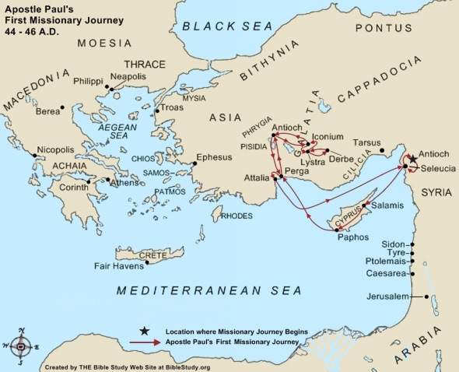
Acts 13
Q1 – 7 (v1 – 12)

Slide 136
Acts 13
Q1 – 7 (v1 – 12)
Bar-Jesus (Elymas), magician
Full of deceit and fraud, son of the devil, enemy of all righteousness, perverting the Lord’s straight ways. (v10-11)
Sergius Paulus, Governor of Cyprus
Believed when he saw the miracle
Astonished at the teaching (v12)

Slide 137
Acts 13
Q8 – 10 (v13 – 41)
They leave Cyprus sailing to Perga.
John Mark left them to go back to Jerusalem. (v13)

Slide 138
Acts 13
Q1 – 7 (v1 – 12)

Slide 139
Acts 13
Q8 – 10 (v13 – 41)
They leave Cyprus sailing to Perga.
John Mark returns to Jerusalem.
In the synagogue, Paul is asked to speak to the group. (v15)

Slide 140
Acts 13
Q8 – 10 (v13 – 41)
Paul’s Sermon:
The history of the Children of Israel included the prophecy of Christ. (17-23)
The story (history) of Christ. (24-31)
Christ Jesus is the fulfillment of prophecy. Three supporting O.T. passages quoted. (32-41) Psalm 2:7; Isa 55:3; Psalm 16:10

Slide 141
Acts 13
Q8 – 10 (v13 – 41)
Paul’s Sermon:
Acts 13:38-39 Therefore let it be known to you, brethren, that through this Man is preached to you the forgiveness of sins; (39) and by Him everyone who believes is justified from all things from which you could not be justified by the law of Moses.

Slide 142
Acts 13
Q8 – 10 (v13 – 41)
Paul’s Sermon:
Act 13:40-41 Beware therefore, lest what has been spoken in the prophets come upon you: (41) Behold, you despisers, Marvel and perish! For I work a work in your days, A work which you will by no means believe, Though one were to declare it to you.

Slide 143
Acts 13
Q11 – 15 (v42 – 52)
The people want to hear more.
Many of the Jews and devout proselytes followed Paul and Barnabas.
Almost the whole city came to hear.
Other Jews (despisers) were filled with envy. They opposed the things spoken.

Slide 144
Acts 13
Q11 – 15 (v42 – 52)
Paul and Barnabas grew bold. (spoke out boldly – ESV)
Isa 49:6 Indeed He says, 'It is too small a thing that You should be My Servant To raise up the tribes of Jacob, And to restore the preserved ones of Israel; I will also give You as a light to the Gentiles, That You should be My salvation to the ends of the earth.'

Slide 145
Acts 13
Q11 – 15 (v42 – 52)
Paul and Barnabas grew bold. (spoke out boldly – ESV)
Acts 13:48 And when the Gentiles heard this, they began rejoicing and glorifying the word of the Lord, and as many as were appointed to eternal life believed.

Slide 146
Acts 13
Q11 – 15 (v42 – 52)
The Jews incited some leading men and women to stir up trouble against them.
Paul and Barnabas shook the dust from their feet.
Traveled to Iconium.

Slide 147
Acts 13
Q1 – 7 (v1 – 12)

Slide 148
Acts 13
Q11 – 15 (v42 – 52)
The Jews incited some leading men and women to stir up trouble against them.
Paul and Barnabas shook the dust from their feet.
Traveled to Iconium.
The disciples were filled with joy and the Holy Spirit.

Slide 149
Acts 13
Discussion concerning Acts 13:42. The KJV and NKJV indicate the Gentiles ask to hear more.
Ethnos – a race, people, nation; the nations, heathen world, Gentiles.
Found in chapter 13, in verses:
19 – nations
46 – gentiles
47 – gentiles
48 – gentiles

Slide 150
Acts 13
Auton (or autos) – a personal pronoun such as he, she, it, they, them.
Found in chapter 13, in verse 42:
KJV and NKJV – Gentiles
ESV, NRSV and NASV – people
ASV – they
As they went out, the people begged that these things might be told them the next Sabbath. (ESV)

Slide 151
Acts 13
Auton (or autos) – a personal pronoun such as he, she, it, they, them.
Found in chapter 13, in verse 42:
KJV and NKJV – Gentiles
ESV, NRSV and NASV – people
ASV – they
And as they went out, they besought that these words might be spoken to them the next sabbath. (ASV)

Slide 152
Acts 13
Act 13:42-43 As they went out, the people begged that these things might be told them the next Sabbath. (43) And after the meeting of the synagogue broke up, many Jews and devout converts to Judaism followed Paul and Barnabas, who, as they spoke with them, urged them to continue in the grace of God. (ESV)

Slide 153
Acts 13
Acts 13:42-43 And as they went out, they besought that these words might be spoken to them the next sabbath. 43 Now when the synagogue broke up, many of the Jews and of the devout proselytes followed Paul and Barnabas; who, speaking to them, urged them to continue in the grace of God. (ASV)

Slide 154
Acts 13
Acts 13:42-43 So when the Jews went out of the synagogue, the Gentiles begged that these words might be preached to them the next Sabbath. (43) Now when the congregation had broken up, many of the Jews and devout proselytes followed Paul and Barnabas, who, speaking to them, persuaded them to continue in the grace of God. (NKJV)

Slide 155
Acts 13
In verses a week later: (ethnos is used)
46 – gentiles (“we turn to the Gentiles”)
47 – gentiles (“a light to the Gentiles”)
48 – gentiles (“the Gentiles heard”)
Luke means to be specific and uses the word “ethnos” – a race, people, nation; the nations, heathen world, Gentiles.

Slide 156
The Book of Acts

Slide 157
Acts Review
In Jerusalem:
Baptism of the Holy Spirit.
Preaching on the day of Pentecost.
Preaching at the temple.
Sadducees\High Priests fear loss.
Peter & John jailed twice, beaten once.
Stephen is stoned.
Christians number in the many thousands including many priests who are converted.

Slide 158
Acts Review
Out of Jerusalem:
Persecution of the church. Saul was a key figure. Christians leave Jerusalem.
Philip preached in Samaria and the plain of Sharon from Azotus to Caesarea.
Ethiopian converted by Philip.
Saul converted in Damascus.
Peter teaches Cornelius and household.
The gospel spreads geographically and outside the Jewish nation.

Slide 159
Acts Review
Paul’s Missionary Journeys:
1st Journey – Antioch, Cyprus, Galatia
Chapters 13 – 14

Slide 160
Acts 14
Q1 – 3 (v1 – 7)
Left Antioch and traveled to Iconium.
Approximately 80 miles.

Slide 161
Acts 13
Q1 – 7 (v1 – 12)

Slide 162
Acts 14
Q1 – 3 (v1 – 7)
Didn’t they turn to the Gentiles?
Gospel is for all nations, not just a select group. Not just Jews, Not just Gentiles.
Unbelieving Jews poisoned the mind of the Gentiles
“Therefore”…

Slide 163
Acts 14
Q1 – 3 (v1 – 7)
“Therefore”…
They stayed a long time.
They spoke boldly in the Lord.
They did signs and wonders…
…bearing witness to the word of His grace.
City was divided – violence against them planned.

Slide 164
Acts 14
Q4 – 7 (v8 – 20)
Man lame from birth is healed.
Temple of Zeus – with a priest.
Conclusions?
The priest of Zeus could not have healed the man?
The priest of Zeus was just as impressed as the others?

Slide 165
Acts 14
Q4 – 7 (v8 – 20)
They thought Paul and Barnabas were gods. (v11)
What was used to confirm who the true God was?
Creation
Rain
Food

Slide 166
Acts 14
Q4 – 7 (v8 – 20)
Jews from other cities were able to persuade a crowd to attempt to kill him instead of honor him.
Some number of disciples remained in Lystra. (v20)
Paul and Barnabas left for Derbe.

Slide 167
Acts 14
Q8 – 10 (v21 – 28)
After making disciples in Derbe, they returned to the previously visited cities of Lystra, Iconium, and Antioch.
Strengthening and exhorting them. (v22)
Appointing elders (v23)
Acts 6 – “whom we may appoint over this business”
Returned and reported.

Slide 168
Acts 14
Q8 – 10 (v21 – 28)
First Missionary Journey
45 – 47 AD between 2 and 3 years.
Approximately 12 years since the death and resurrection of Christ.

